Slide 1
Advanced Data Analytics & Visualization

Slide 2
Day 1: learning objectives, syllabus, takeaways, and setting expectations. Foundations of Data Analytics

Slide 3
Introduction

Slide 4
Foundations of Data Analytics
How to make informed decisions?
Raw Data is the New Oil
Example – Can you mention one place you used Data Driven Decision Making in everyday life?

Slide 5


Slide 6
Uses of Data Analytics in Modern World
Data is also crucial in a professional sense.
Organizations that use data to drive business strategies often find that they are more confident, proactive, and financially savvy.
As a result, data analytics is important across many industries.
A sneaker manufacturer might look at sales data to determine which designs to continue and which to retire, or a health care administrator may look at inventory data to determine the medical supplies they should order.

Slide 7
Data Analytics as a Domain – About the Subject
Data analytics involves analyzing raw data to find trends, patterns, and insights for informed decision-making.
A data analyst will extract raw data, organize it, and then analyze it, transforming it from incomprehensible numbers into coherent, intelligible information.
Example: Online retail stores analyzing customer buying patterns to boost sales.

Slide 8
Process of Data Analysis
Data Collection: Gathering raw data from different sources (databases, web, social media, etc.)
Data Cleaning: Removing errors or inconsistencies.
Data Analysis: Applying statistical methods, machine learning models, etc.
Interpretation & Reporting: Visualizing and presenting findings for decision-making.

Slide 9




Tools used for Data Analytics

Slide 10
About software we will be using(to update)
Course Delivery: The entire course, except for the initial sessions, will be conducted on Excel, Microsoft Power BI Desktop, Python and SQL.
Accessibility: Power BI Desktop can be accessed using a laptop or desktop.
Device Requirements:
For iOS Devices: iOS 17.0 or later. Apple iPhone 8 Plus onwards
For Windows Devices: Minimum 4GB RAM. Running on Windows OS 7 or higher.
Ensure sufficient memory is available to store the program and its resources.
Powe BI Desktop: https://www.microsoft.com/en-us/power-platform/products/power-bi/downloads
Python : https://www.python.org/downloads/
MYSQL Workbench : https://dev.mysql.com/downloads/workbench/
Excel - you can use Excel whatever version available in your system.

Slide 11
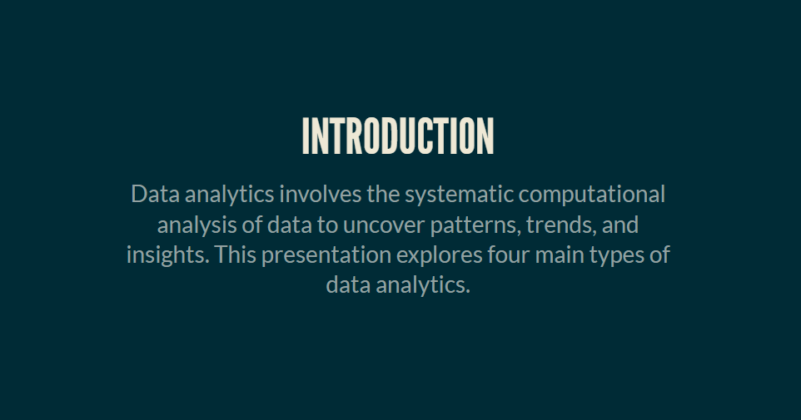

Slide 12
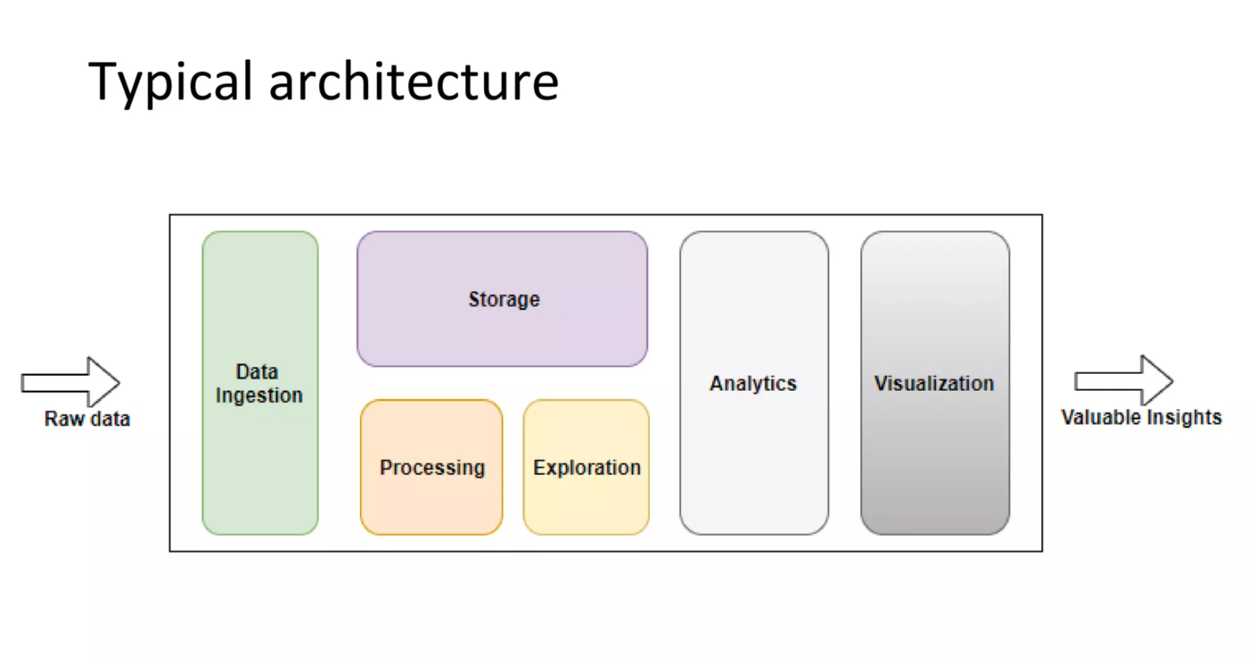

Slide 13
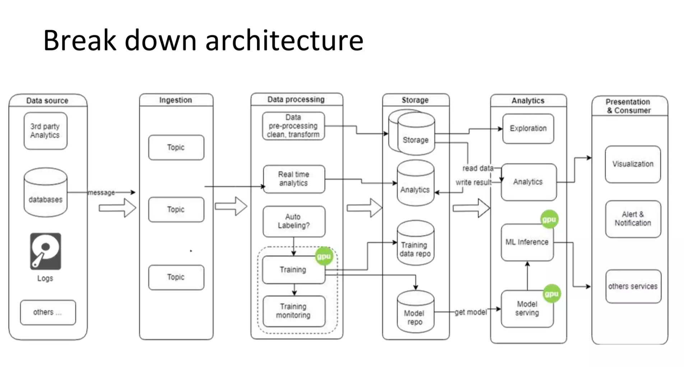

Slide 14
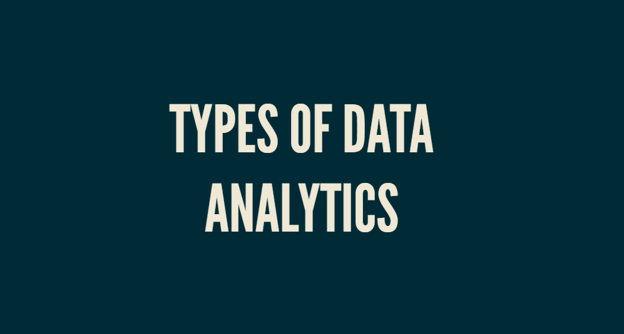

Slide 15
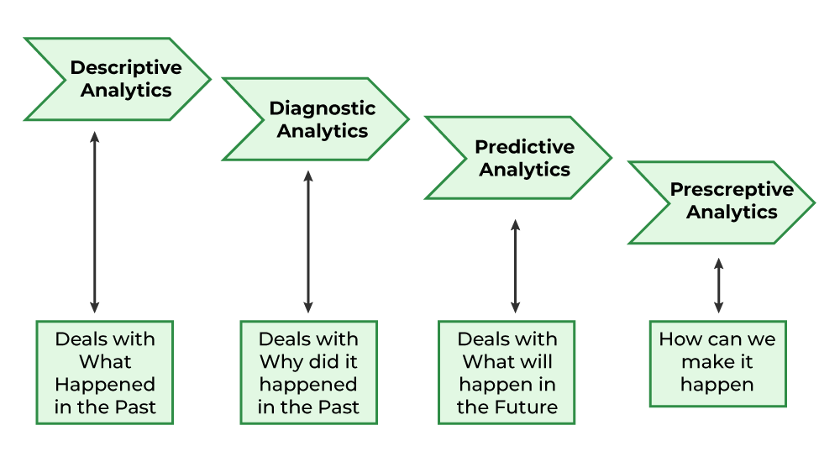

Slide 16
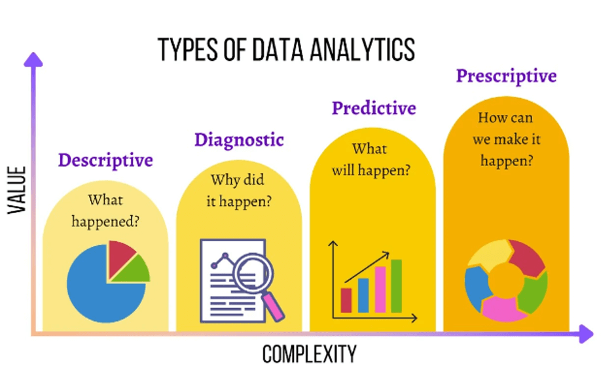

Slide 17
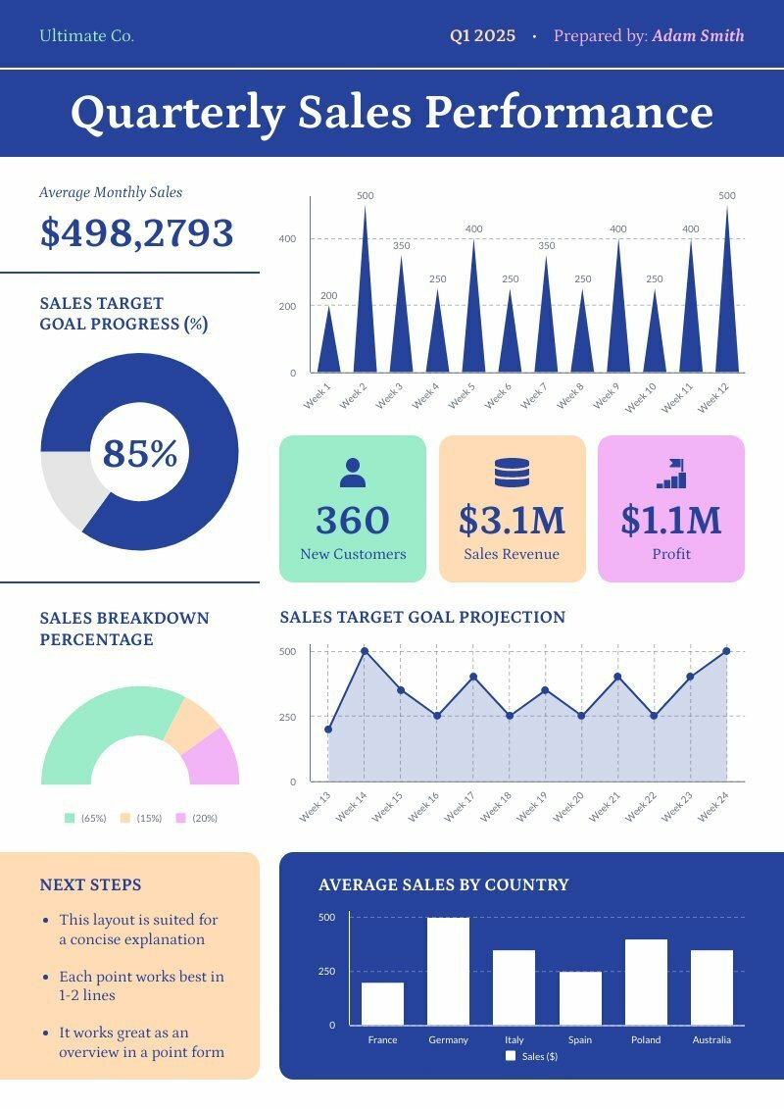
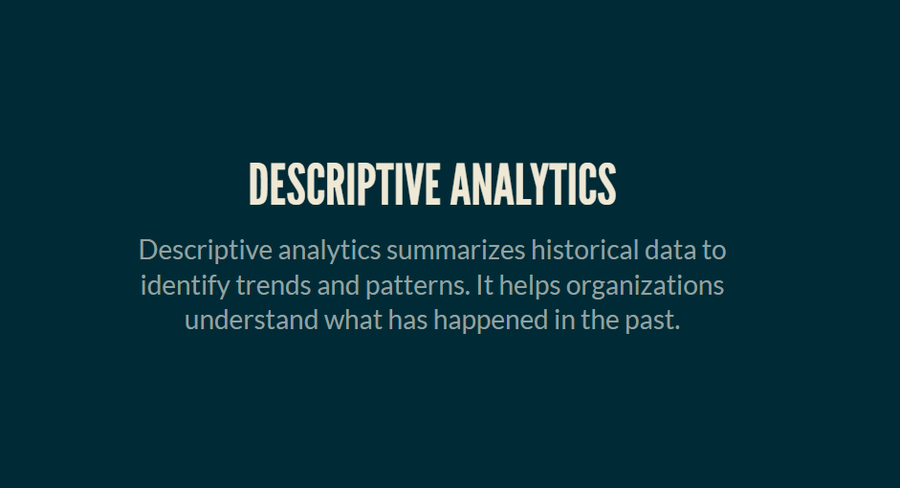

Slide 18
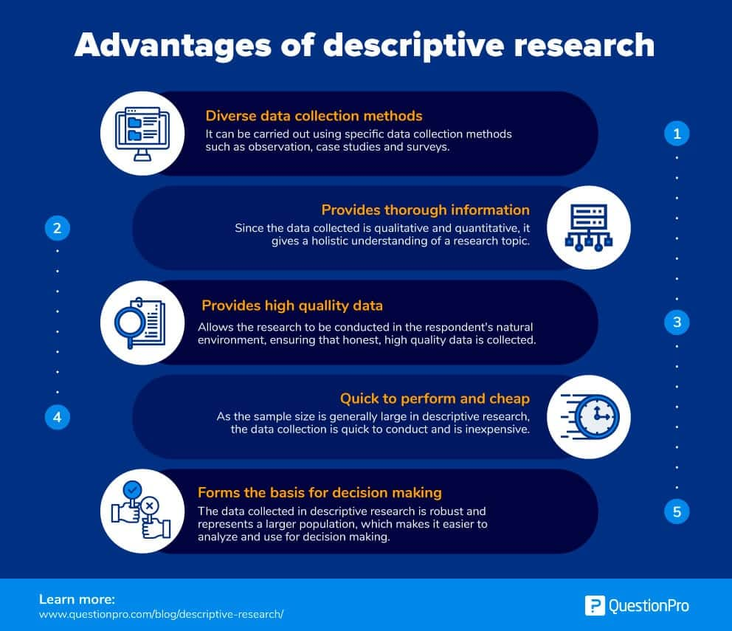

Slide 19

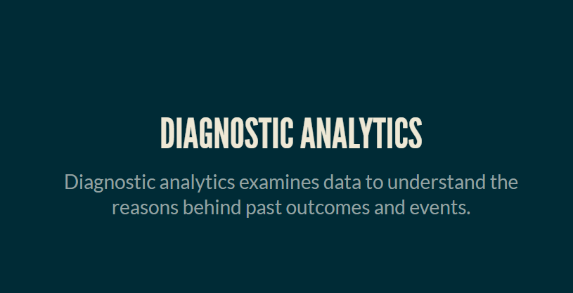

Slide 20
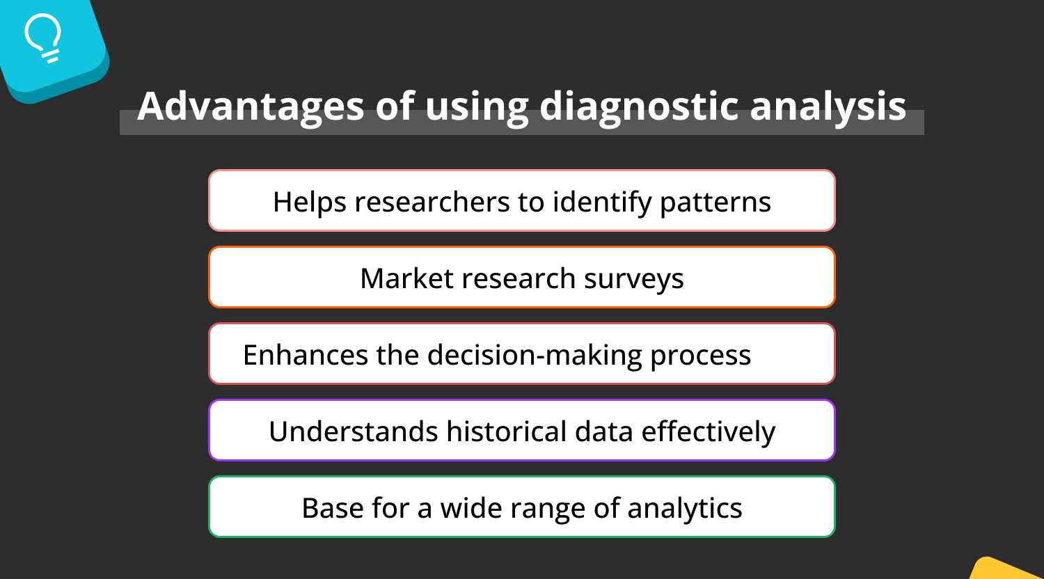

Slide 21

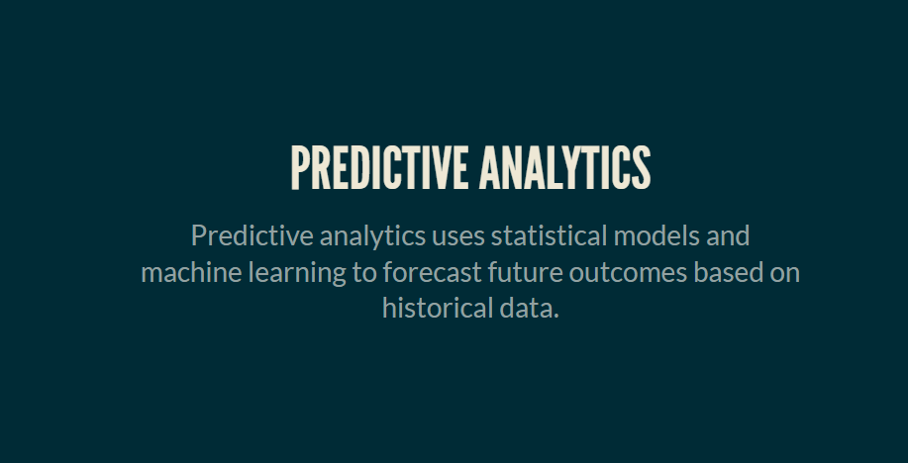

Slide 22
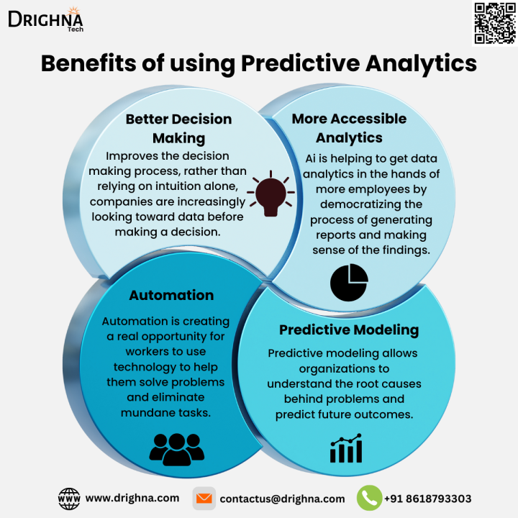

Slide 23

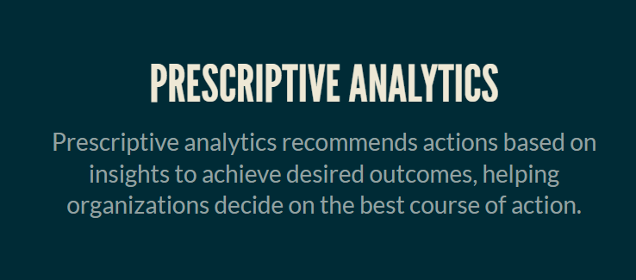

Slide 24
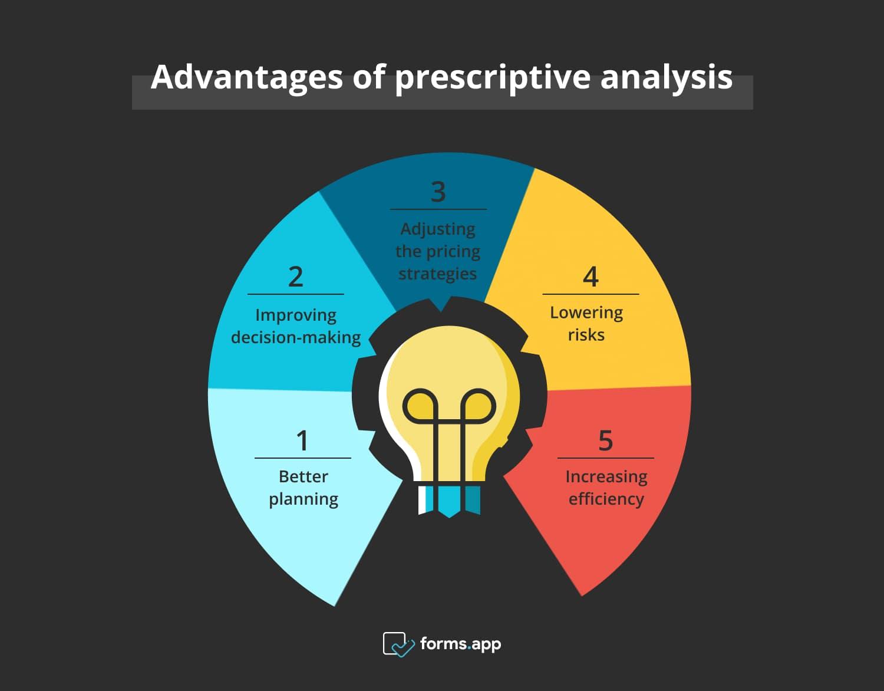

Slide 25
Day 2: Foundations of Data Analytics with EXCEL - data analytics importance, and application areas.

Slide 26
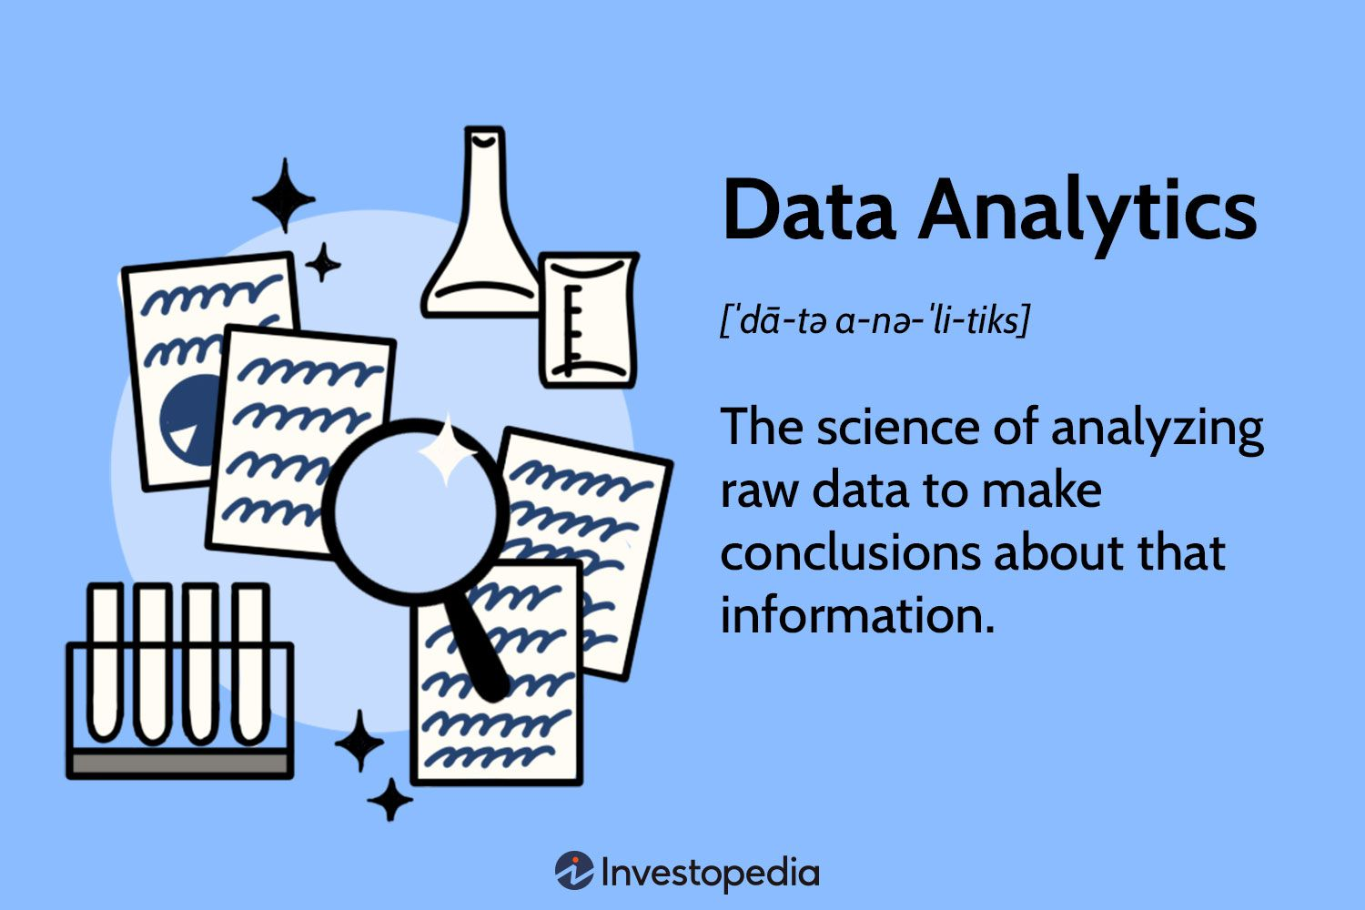
Data analytics importance, and application areas.
Data analytics is important because it helps businesses make better decisions, improve their products and services, and increase revenue. It can also help businesses understand their customers and identify opportunities for growth.

Slide 27
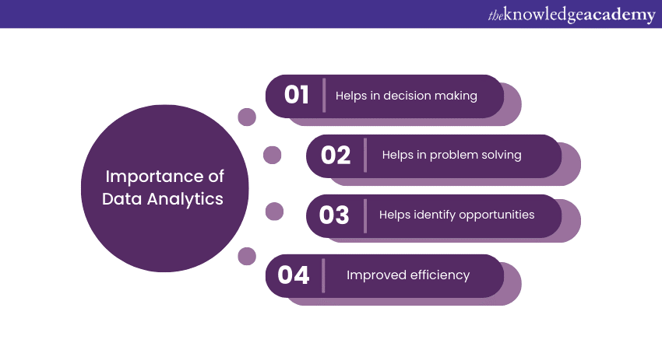
Importance of Data Analytics

Slide 28
Importance of Data Analysis involves inspecting, transforming, and modelling data to discover useful information, inform conclusions, and support decision-making. It encompasses a range of techniques and tools used to interpret raw data, identify patterns, and extract actionable insights
Informed Decision-Making
Improving Business Efficiency
Identifying Market Trends
Enhancing Customer Experience
Driving Innovation
Supporting Evidence-Based Research
Mitigating Risks
Fostering Competitive Advantage

Slide 29
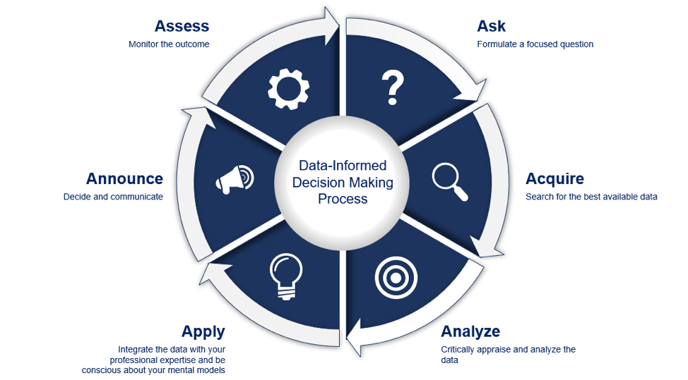
Informed Decision-Making

Slide 30

Improving Business Efficiency

Slide 31
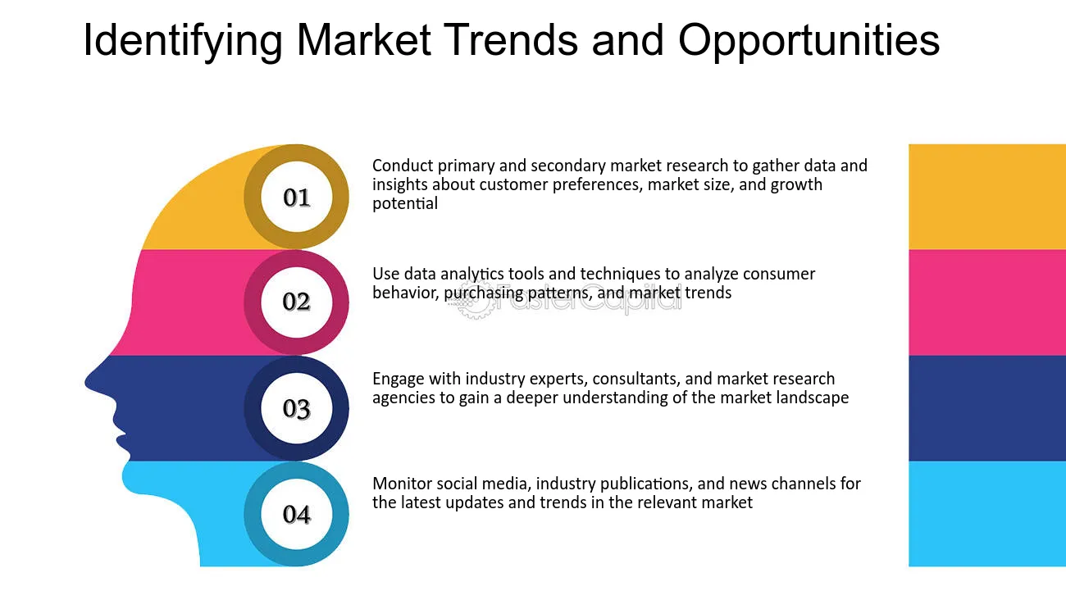
Identifying Market Trends

Slide 32

Enhancing Customer Experience

Slide 33
Driving Innovation

Slide 34

Evidence-Based Research

Slide 35

Mitigating Risks

Slide 36

Fostering Competitive Advantage

Slide 37
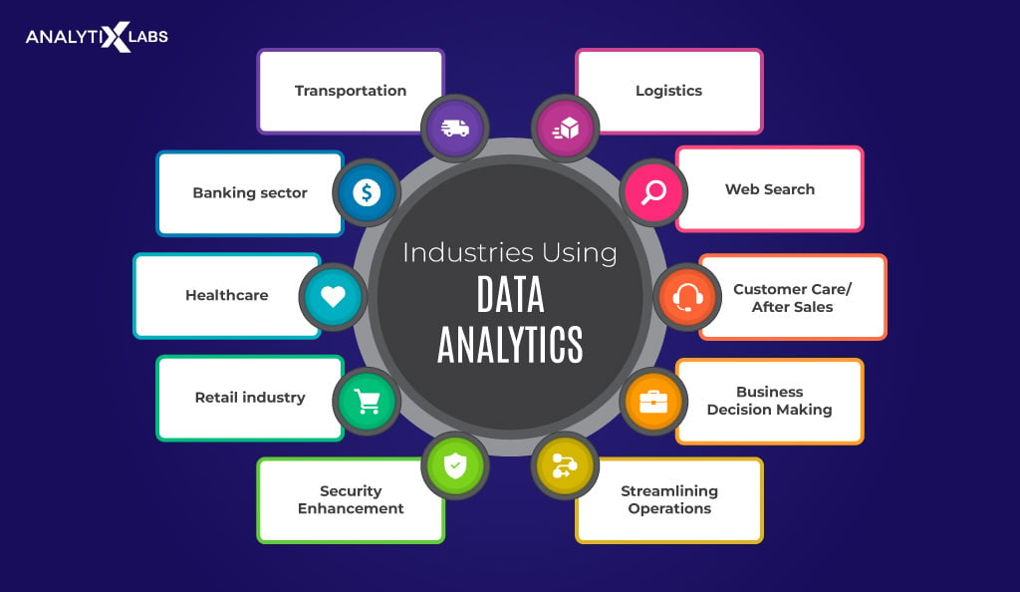
Data Analytics application areas

Slide 38


Banking. Banks employ data analytics to manage risks, gather insights into customer behaviour, and personalize financial services. Using data analytics, banks and credit card companies can customize their offerings, identify potential fraud, and assess potential client creditworthiness by analysing customer demographics, transaction data, and credit histories. Data analytics also helps banks spot money laundering activities and boost regulatory compliance.
Cybersecurity. Data analytics is pivotal in cybersecurity by detecting and preventing cyber-attacks and similar threats. Security systems analyse user behaviour, network traffic, and system logs to locate anomalies and possible security breaches. By leveraging data analytics, businesses and other organizations can proactively enhance their security measures, detect threats, respond to them in real-time, and protect sensitive data.

Slide 39


E-commerce. E-commerce platforms use data analytics to understand customer behavior, optimize marketing campaigns, and personalize shopping experiences. E-commerce companies offer personalized product recommendations, target specific customer segments, and improve customer satisfaction and retention by analyzing customer preferences, purchase histories, and browsing patterns.
Finance. Data analytics plays a vital role in investment strategies, fraud detection, and risk assessment. Banks and other financial institutions analyze vast volumes of data to predict creditworthiness, spot suspicious transactions, and optimize their investment portfolios. Data analytics allows finance companies to offer personalized financial advice and develop creative financial products and services.

Slide 40


Healthcare. Data analytics positively changes the healthcare industry by offering better patient care, disease prevention, and resource optimization. Hospitals can analyze patient data to spot high-risk individuals and provide personalized treatment plans. Data analytics also helps find disease outbreaks, monitor treatment effectiveness, and improve healthcare operations.
Internet Searches. Data analytics powers Internet search engines, letting users find relevant information accurately and quickly. Search engines analyze colossal amounts of data (e.g., web pages, user queries, click-through rates) to deliver the most relevant search results. Additionally, data analytics algorithms continuously learn and adapt to individual user behaviors, providing increasingly accurate and personalized search results.

Slide 41


Logistics. Data analytics is essential in managing fleet operations, optimizing transportation routes, and improving overall supply chain efficiency. Logistics companies can reduce delivery times, minimize costs, and increase demand forecasting, inventory management, and customer satisfaction by analysing delivery times, routes, and vehicle performance data.
Manufacturing. Data analytics revolutionizes manufacturing by optimizing production processes, improving predictive maintenance, and enhancing product quality. Data analytics allows manufacturers to analyse sensor data, machine performance, and historical maintenance records to predict equipment failures, minimize downtime, and guarantee efficient operations. Data analytics also allows manufacturers to monitor production lines in real time, leading to higher productivity and savings.

Slide 42


Supply Chain Management. The recent global pandemic has cast supply chains in a new light. Consequently, data analytics improves supply chain management by reducing costs, optimizing inventory levels, and enhancing overall operational efficiency. Using data analytics, organizations can analyze supply chain data to forecast demand, identify bottlenecks, and improve logistics and distribution processes. Data analytics also enhances transparency throughout the supply chain.
Risk Management. Risks are common in the commercial world, and data analytics is essential in risk management across many industries, such as finance, insurance, and project management. Organizations can use data analysis to assess risks, develop sound mitigation strategies, and make informed decisions by analyzing market trends, historical data, and external factors.

Slide 43


Transportation: Transportation data analytics involves the collection, analysis, and interpretation of data related to transportation systems. It helps identify patterns and trends in transportation behaviour, such as traffic congestion or public transport usage. Data analytics can be used to optimize transportation routes and schedules for efficiency and sustainability. It plays a crucial role in improving safety by identifying accidents-prone areas and suggesting targeted interventions. Transportation data analytics can also aid in predicting demand, optimizing pricing strategies, and enhancing overall user experience in transportation services.
Customer Care: Customer behaviour analytics refers to data sourced from the various touchpoints of customer relationships. Now, more than ever, the customer journey is complicated. Attempting to map out a customer’s journey might feel like a disjointed scavenger hunt. Of course, it doesn’t have to be. A modern customer behavior analytic strategy should keep you on top of the big data that informs your support strategy, product roadmap, marketing campaigns, and sales efforts.

Slide 44
Real-World Data Analytics Applications Examples
1. Identifying Cancer Tumors
Google developed a tool called LYNA for identifying breast cancer tumors that metastasize to nearby lymph nodes. That can be difficult for the human eye to see, especially when the new cancer growth is small. In one trial, LYNA — short for Lymph Node Assistant — accurately identified metastatic cancer 99 percent of the time using its machine-learning algorithm. More testing is required, however, before doctors can use it in hospitals.
2. Tracking Menstrual Cycles
The popular Clue app employs data science to forecast users’ menstrual cycles and reproductive health by tracking cycle start dates, moods, stool type, hair condition and other metrics. Behind the scenes, data scientists mine this wealth of anonymized data with tools like Python and Jupiter's Notebook. Users are then algorithmically notified when they’re fertile, on the cusp of a period or at an elevated risk for conditions like an ectopic pregnancy.

Slide 45
Real-World Data Analytics Applications Examples
3. Personalizing Treatment Plans
Oncora’s software uses machine learning to create personalized recommendations for current cancer patients based on data from past ones. Healthcare facilities using the company’s platform include UT Health San Antonio and Scripps Health. Doctors can spend up to two-thirds of their time working on clinical documentation, so employing Oncora’s platform helped cut down on paperwork and enabled doctors to be more efficient.
4. Cleaning Clinical Trial Data
Veeva is a cloud software company that provides data and software solutions for the healthcare industry. The company’s reach extends through clinical, regulatory and commercial medical fields. Veeva’s Vault EDC uses data science to clean clinical trial findings and help medical professionals make adjustments mid-study.

Slide 46
Real-World Data Analytics Applications Examples
5. Modeling Traffic Patterns
StreetLight uses data science to model traffic patterns for cars, bikes and pedestrians on North American streets. Based on a monthly influx of trillions of data points from smartphones, in-vehicle navigation devices and more, Streetlight’s traffic maps stay up-to-date. They can even identify groups of commuters who use multiple transit modes to get to work, like a train followed by a scooter. The company’s maps inform various city planning enterprises, including commuter transit design.
6. Optimizing Food Delivery
The data scientists at UberEats have a fairly simple goal: getting hot food delivered quickly. Making that happen across the country, though, takes machine learning, advanced statistical modelling and staff meteorologists. In order to optimize the full delivery process, the team has to predict how every possible variable — from storms to holiday rushes — will impact traffic and cooking time.

Slide 47
Real-World Data Analytics Applications Examples
7. Improving Package Delivery
UPS uses data science to optimize package transport from drop-off to delivery. The company’s integrated navigation system ORION helps drivers choose over 66,000 fuel-efficient routes. ORION has saved UPS approximately 100 million miles and 10 million gallons of fuel per year with the use of advanced algorithms, AI and machine learning. The company plans to continue to update its ORION system, with the last version having been rolled out in 2021. The latest update allowed drivers to reduce their routes by two to four miles.
8. Enhancing Supply Chain Management
XPO Logistics has embraced a data analytics-first approach to manage ingoing and outgoing orders more effectively. With historical shipment data, the company can predict where it will need to build infrastructure to support more orders and allocate human personnel accordingly. In addition, XPO Logistics has replaced manual data entry with scanners that help workers determine where shipments need to go within the company’s supply chain network.

Slide 48
Understand the Data File:
Understand the data: Know the context of the data to avoid misinterpreting it.
Back up the data: Always back up your data before cleaning.
Remove outliers: Outliers can distort your view of a variable and negatively impact your model.
Fill missing values: Missing values can be caused by poor data records or data entry errors.
Clear formatting: Databases from different systems may have unique formatting that can disrupt your spreadsheet.
Transform and organize data: Reshape and rearrange your data to make it easier to analyse and interpret.
Format the text: Fix extra spaces, typing mistakes, and inconsistent casing.
Use data validation: Only allow valid values to be entered into cells.
Use the TRIM function: Remove extra spaces in text strings.
Use the Text to Columns feature: Split concatenated data within a cell into separate columns.

Slide 49
Sample Excel Data
Discuss about Retail Sales Analysis data file to understand what are all the Sheets and fields are present.

Slide 50
Day 3: Cleaning and formatting data using Excel

Slide 51
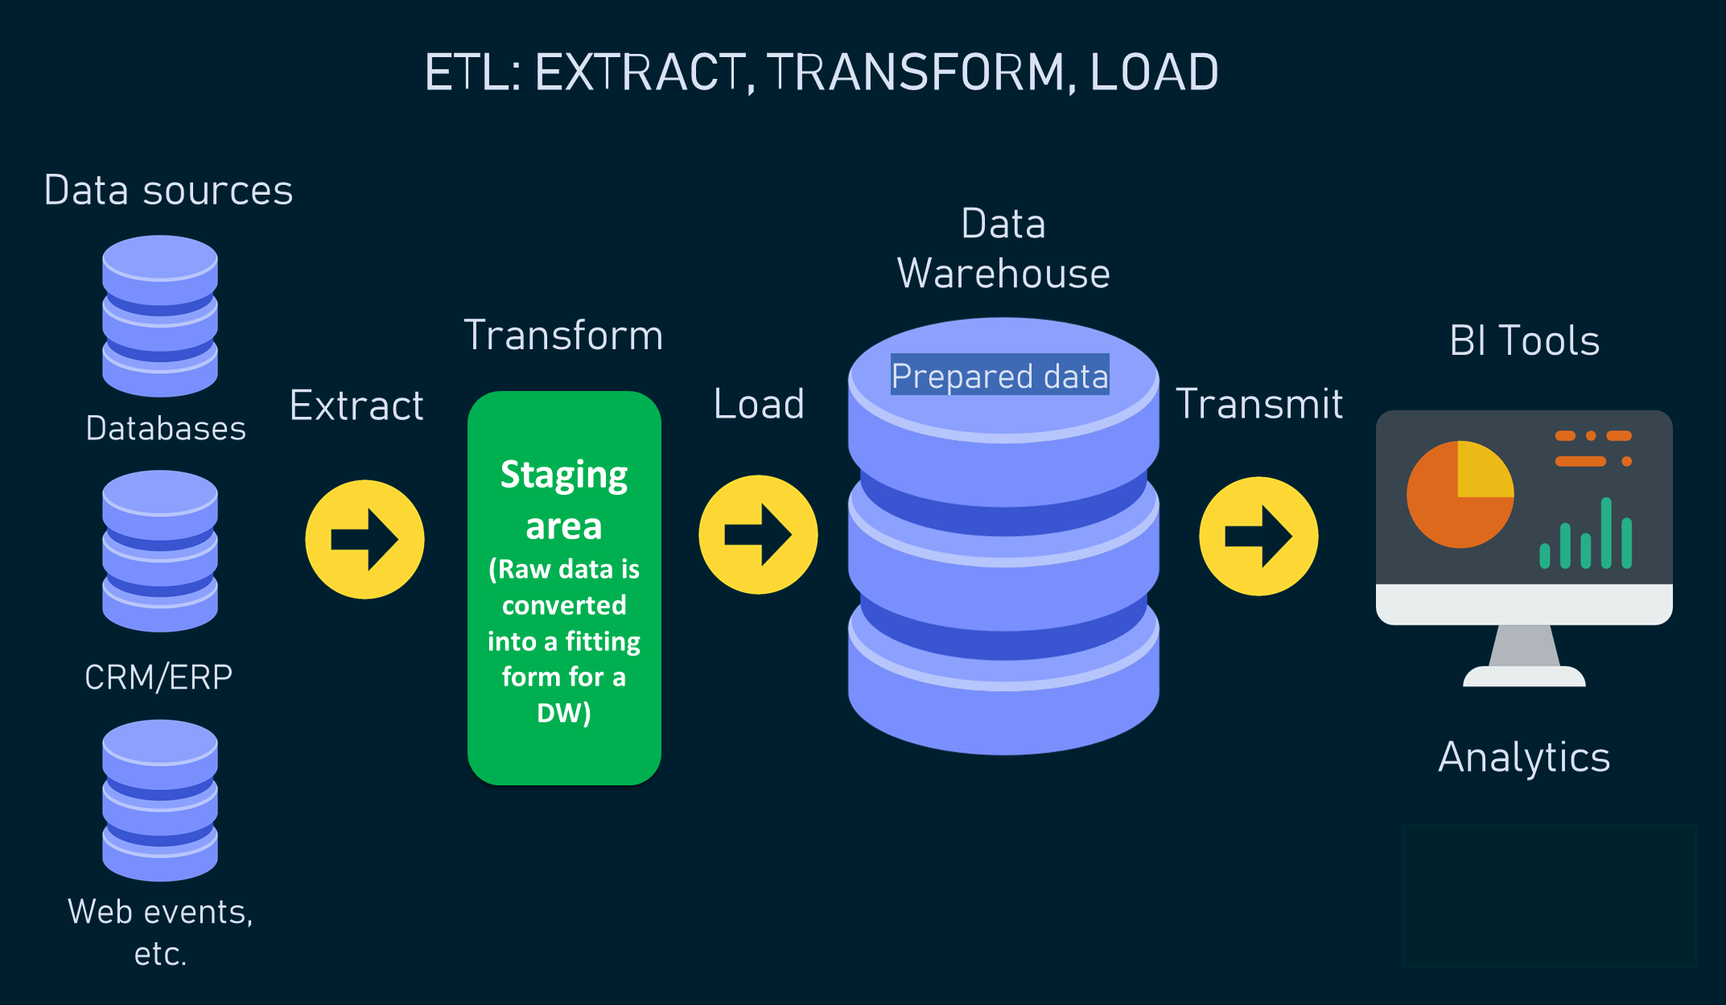

Slide 52
Data Analytics with EXCEL
Data analytics importance, and application areas.
Cleaning and formatting data using Excel,
handling missing values, and outlier detection.
Using formulas, pivot tables, and conditional formatting for analysis

Slide 53
Cleaning and formatting data using Excel
Remove duplicates: Remove duplicate data from a list
Fix errors: Correct errors like missing or incorrect email addresses
Convert data types: Use Query to detect and change data types
Add formulas: Add a formula to a new column to transform data, then copy and paste the values into the new column
Use add-ins: Use add-ins like Data Cleaner to automate data editing

Slide 54
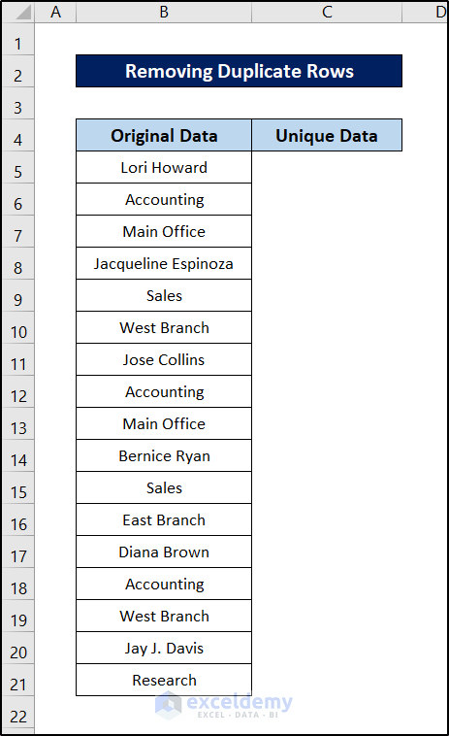
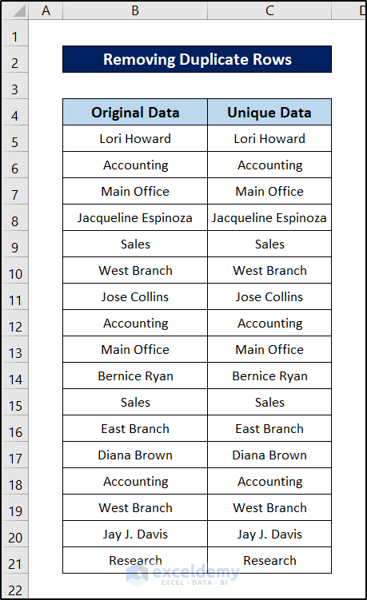
Cleaning and formatting data using Excel
Method 1 – Remove Duplicate Rows
Let’s replicate the column and remove the duplicates to compare them later on.

Slide 55

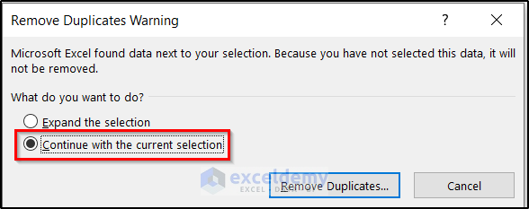
Steps:
Select the column you want to remove the duplicates from.
Go to the Data tab on your ribbon.
Select Remove Duplicates from the Data Tools group.
Select the Continue with the current selection option in the pop-up box and click on Remove Duplicates.

Slide 56
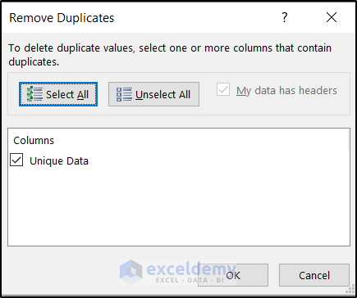
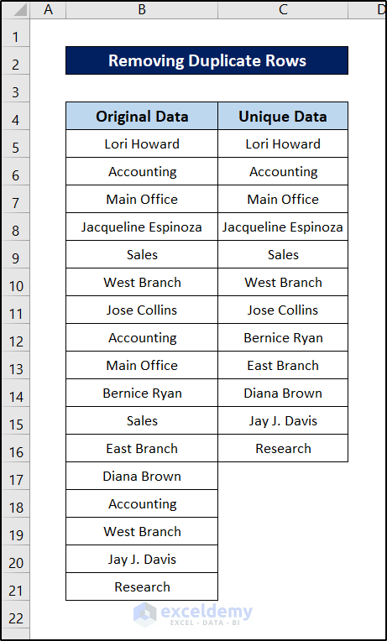

Click on OK.
This will remove all the duplicates from the selection.

Slide 57
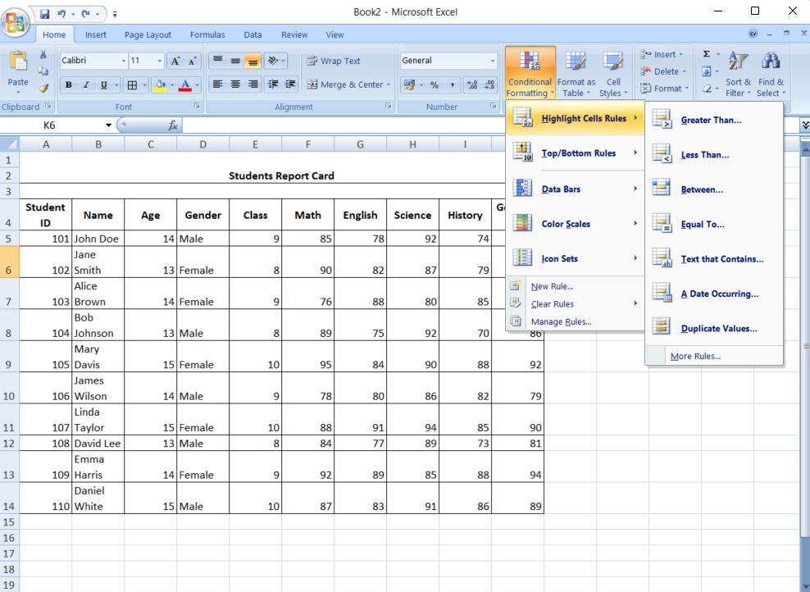
Conditional Formatting: An Overview
Conditional Formatting allows you to apply specific formatting—such as colors, icons, or data bars—to cells based on the values they contain. This automatic formatting is triggered by rules you define, making it easy to spot critical data points or trends without manually sifting through numbers.

Slide 58
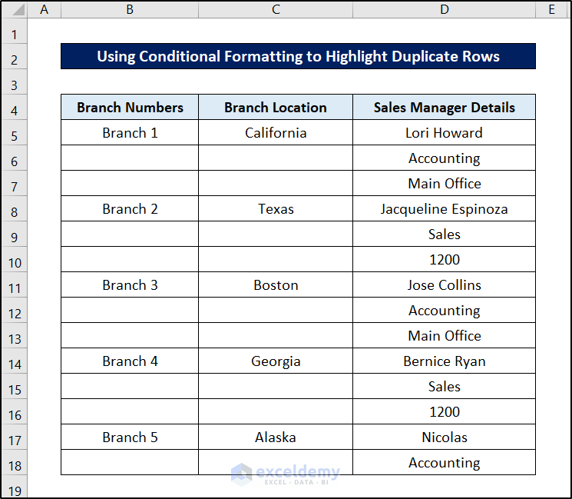
Method 2 – Highlight Duplicate Values
Utilizing Conditional Formatting
We’ll use the following dataset.

Slide 59
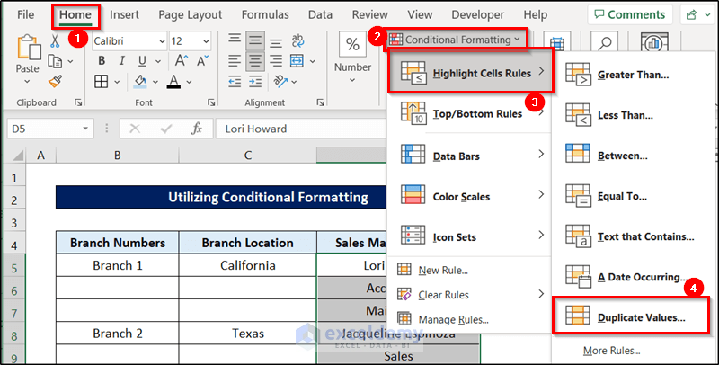
Steps:
Select the cells that we want to highlight. In this case, it is D5:D18.
Go to Home and choose Conditional Formatting.
Go to Highlight Cells Rules and select Duplicate Values.

Slide 60
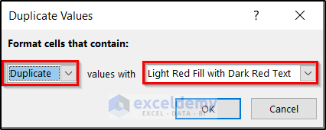
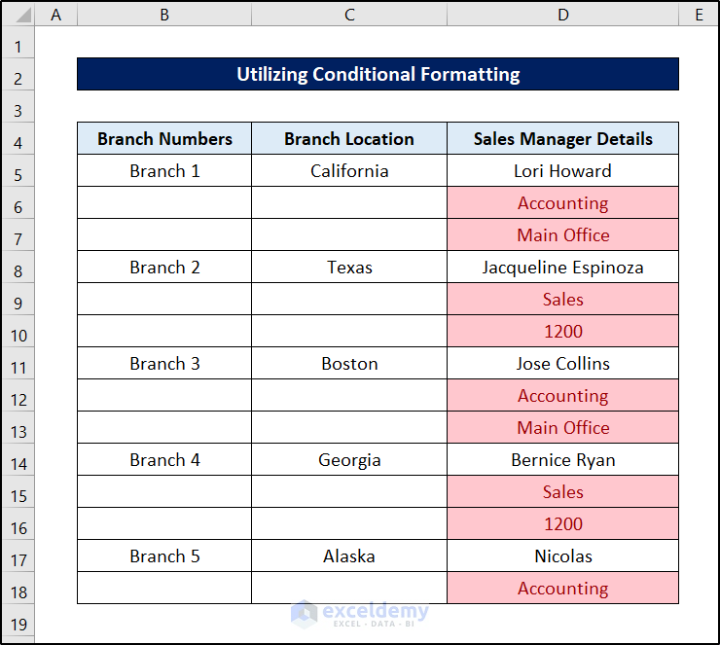
A Duplicate Values window will appear. Choose Duplicate.
Select any color options after values with. We have selected Light Red Fill with Dark Red Text.
The duplicate values in the D column
are highlighted.

Slide 61
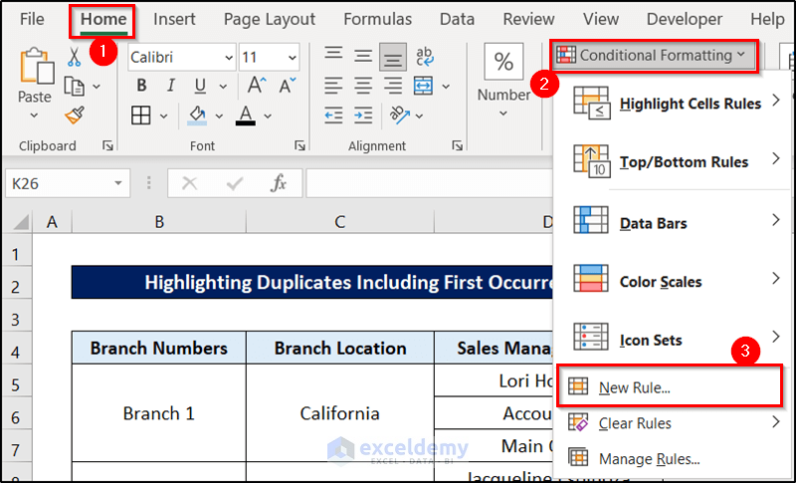
Highlighting Duplicates Including First Occurrence
Steps:
Go to New Formatting Rule through the Conditional Formatting option.

Slide 62
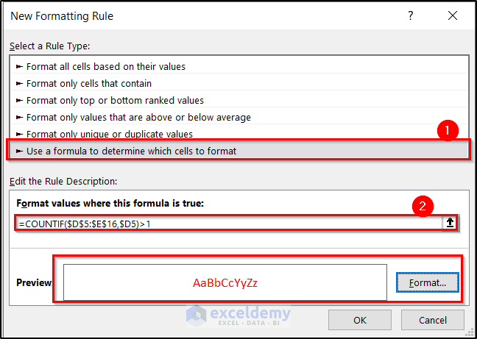
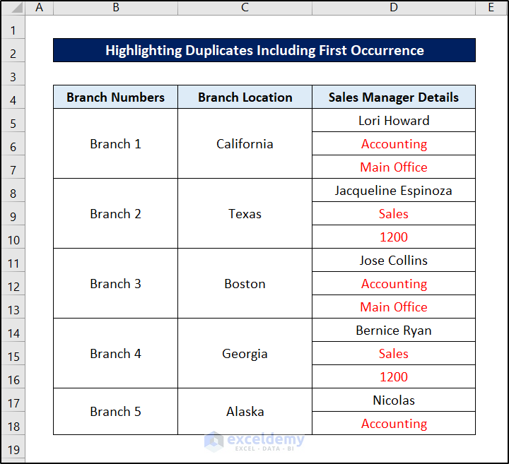
Select Use a formula to determine which cells to format.
Use the following formula in the formula box.
=COUNTIF($D$5:$E$16,$D5)>1 Result:
Click OK for the result.

Slide 63
Highlighting Duplicates Excluding First Occurrence
Steps:
Go to New Formatting Rule through the Conditional Formatting option.

Slide 64
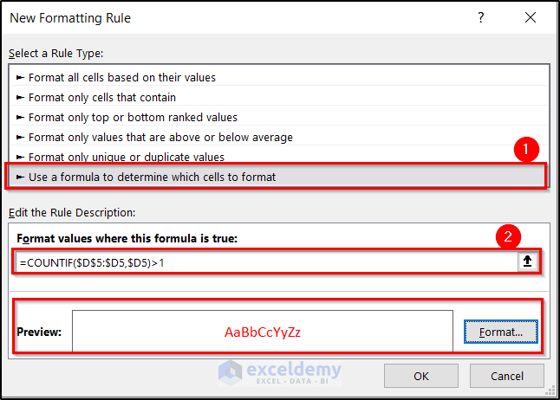
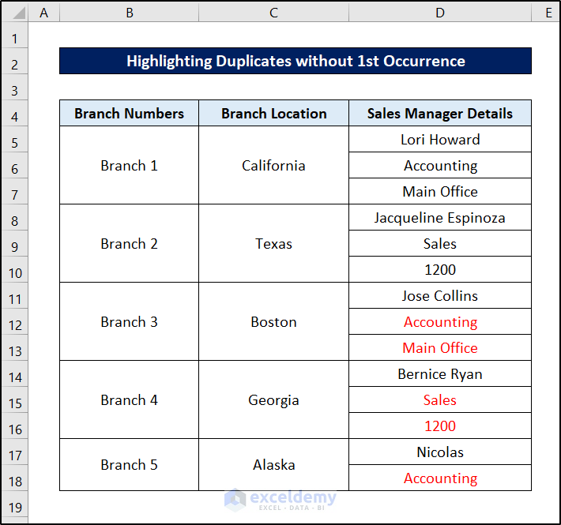
Select Use a formula to determine which cells to format.
Use the following formula in the formula box.
=COUNTIF($D$5:$D5,$D5)>1 Result:
Click OK for the result.

Slide 65
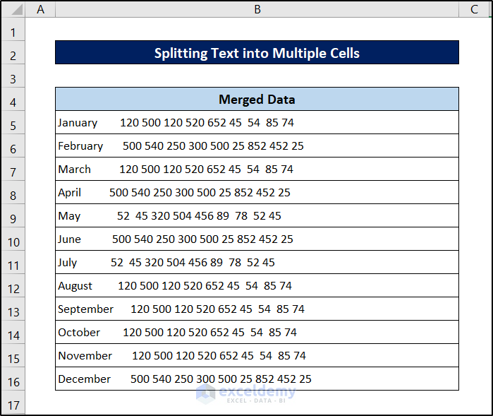
Method 3 – Split Text into Multiple Cells
Here’s a dataset where each cell has multiple values that need to be split.

Slide 66

Steps:
Select the range you want to split text from.
Go to the Data tab on your ribbon.
From the Data Tools group, select Text to Columns.

Slide 67
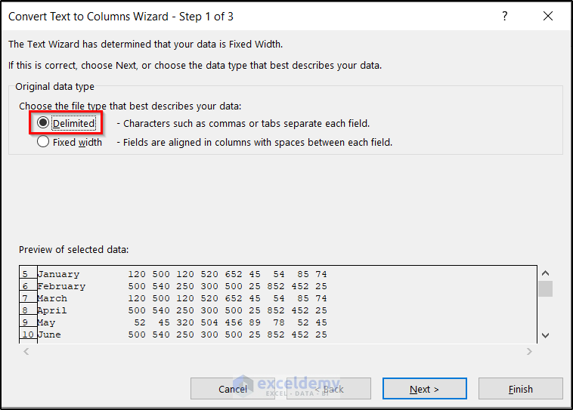
Select Delimited in the next box.

Slide 68
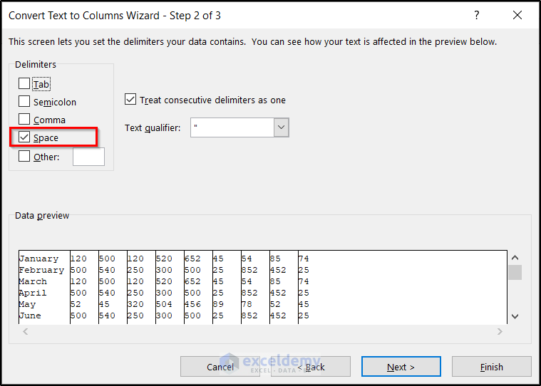
After clicking on Next, another box will appear.
Select Space under Delimiter options as the text is divided by spaces.
Click on Next.

Slide 69
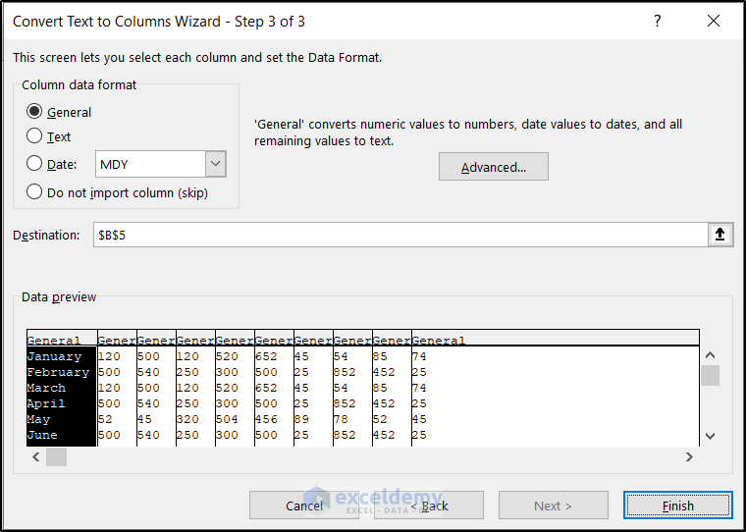
Click on Finish.

Slide 70
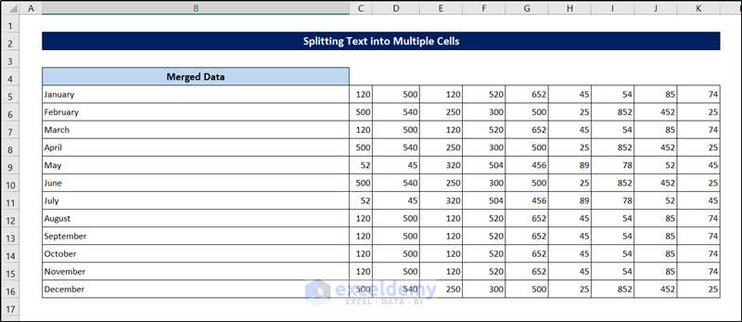
The text will be split.

Slide 71
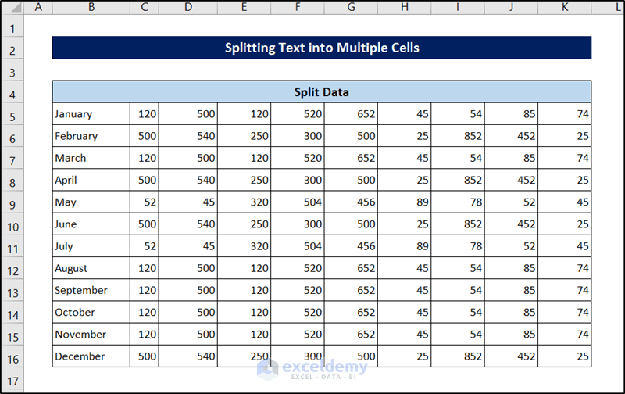
Let’s make some modifications to make the data more presentable.

Slide 72
Day 4: handling missing values, and outlier detection in EXCEL

Slide 73
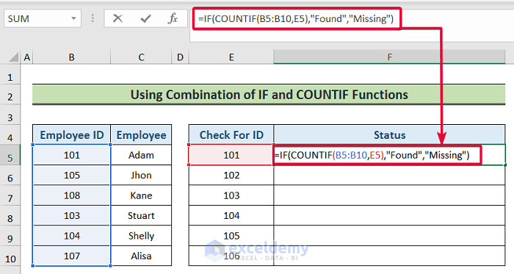
Method 1 – Using Combination of IF and COUNTIF Functions
Steps:
Select the F5 cell and write the following formula:
=IF(COUNTIF(B5:B10,E5),"Found","Missing")
Press Enter.

Slide 74
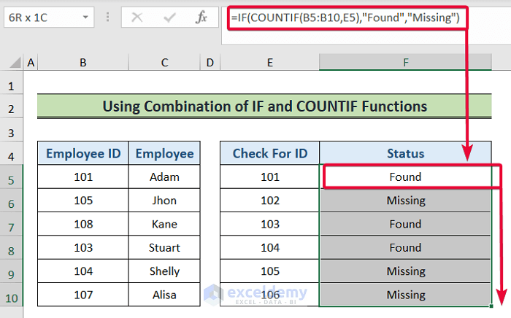
You will find the values that are missing from the Employee ID list.

Slide 75
Formula Breakdown:
COUNTIF(B5:B10,E5): The COUNTIF function counts the number of cells that satisfy a specified criterion. It returns zero if no cells satisfy the requirement. In this case, the function will go through the range (B5:B10) and look for the value in the E5 If it finds it, then it will return 1. Otherwise, it will return zero.
IF(COUNTIF(B5:B10,E5),”Found”,”Missing”): Any non-zero value will be treated as TRUE by the IF function, and zero will be treated as FALSE. In the formula, the COUNTIF function will either return zero or one. If it returns zero, the IF function will treat it as FALSE and will return “Missing”, the second output. And if the COUNTIF function returns one, then the IF function will return “Found”. In this particular case, the COUNTIF function will return 1, and thus the IF function will return “Found”.

Slide 76
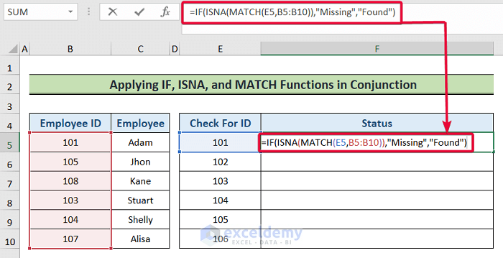
Method 2 – Combining IF, ISNA, and MATCH Functions
Steps:
Choose cell F5 and enter the following formula:
=IF(ISNA(MATCH(E5,B5:B10)),"Missing","Found")
Press Enter..

Slide 77
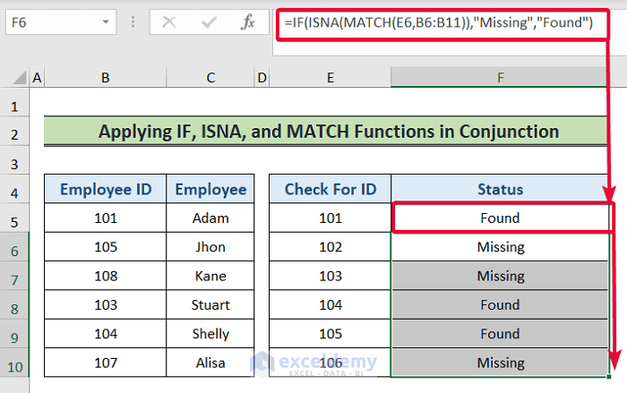
You will discover the missing values from the Employee IDcolumn.

Slide 78
Formula Breakdown:
MATCH(E5,B5:B10): The MATCH function goes through a range looking for a particular value. If it finds the value, then it returns the position of the value in numeric value. In this case, the MATCH function will find a match in the range (B5:B10) for the value in the E5 cell and will return a numeric value as its position in the range.
ISNA(MATCH(E5,B5:B10)): The ISNA function returns TRUE if a formula returns the #N/A error value; otherwise, it returns FALSE. Here, the MATCH function will return a numeric value and so the ISNA function will assign FALSE to that value.
IF(ISNA(MATCH(E5,B5:B10)),”Missing”,”Found”): The IF function evaluates the first argument. If the argument is TRUE then it returns the second argument and if not, it returns the third argument. Here, the ISNA function will return FALSE and so the IF function will return “Found”. This means the value is present in the (B5:B10)

Slide 79
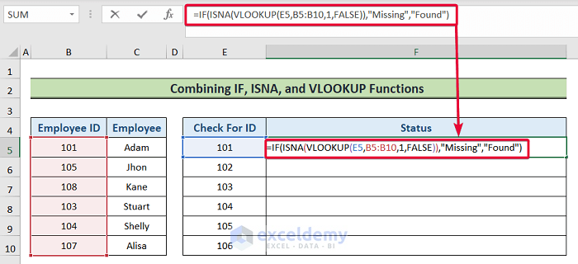
Method 3 – Applying IF, ISNA, and VLOOKUP Functions in Conjunction
Steps:
=IF(ISNA(VLOOKUP(E5,B5:B10,1,FALSE)),"Missing","Found")
Press the Enter button.

Slide 80
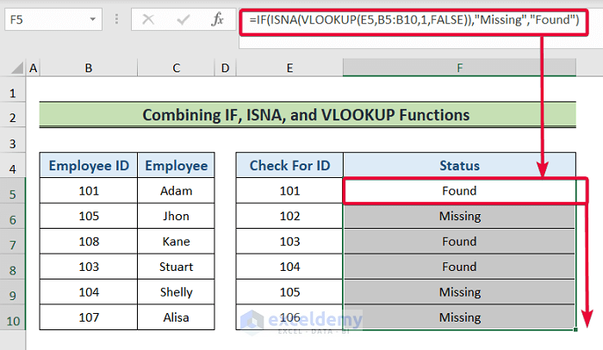
You will see what values are missing from the Employee ID column.

Slide 81
Formula Breakdown:
VLOOKUP(E5,B5:B10,1,FALSE): Here, the VLOOKUP function will look for the value in the E5 cell in the (B5:B10) If it finds the value, then it will return 1, otherwise, it will return FALSE.
ISNA(VLOOKUP(E5,B5:B10,1,FALSE)): The ISNA function returns TRUE if a formula returns the #N/A error value; otherwise, it returns FALSE. Here, the VLOOKUP function will return 1 and so the ISNA function will assign FALSE to that value.
IF(ISNA(MATCH(E5,B5:B10)),”Missing”,”Found”): The initial argument is assessed by the IF function. If the argument is TRUE then it returns the second argument, and if not, it returns the third argument. Here, the ISNA function will return FALSE, and so the IF function will return “Found”. This means the value is present in the (B5:B10)

Slide 82
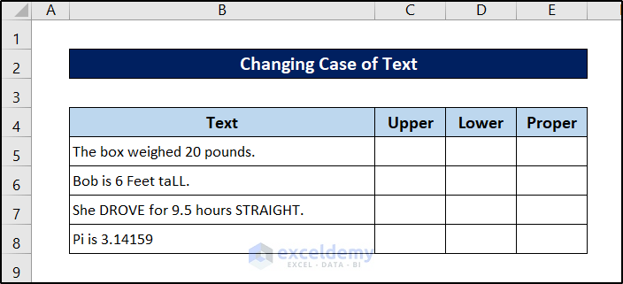
Method 4 – Transforming Data with Formulas
The three formulas to change text are:
UPPER: This formula converts the text to ALL UPPERCASE.
LOWER: This formula converts the text to all lowercase.
PROPER: This one converts the text to Proper Case (the first letter in each word will be capitalized, as in a proper name).
We will use the following dataset.

Slide 83
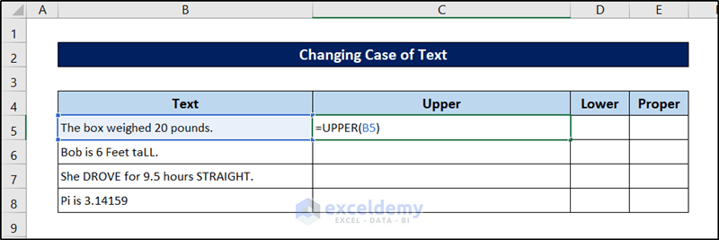
Changing to Upper Case
Steps:
Select cell C5.
Use the following formula in it.
=UPPER(B5)

Slide 84


Press Enter.
Select the cell again and click and drag the fill handle icon down to fill the rest of the cells with the formula.

Slide 85

Changing to Lower Case
Steps:
Select cell D5.
Use the following formula in it.
=LOWER(B5)

Slide 86


Press Enter.
Select the cell again and click and drag the fill handle icon down to fill the rest of the cells with the formula.

Slide 87


Changing to Proper Case
Steps:
Select cell E5.Use the following formula in it.
=PROPER(B5) , Press Enter.
Select the cell again and click and drag the fill handle icon down to fill out the rest of the cells.

Slide 88

Method 5 – Remove Extra Spaces
We have a dataset where the values have extra spaces between them.
Using the TRIM Function
The TRIM function removes all leading and trailing spaces from a text and replaces multiple spaces with a single space.

Slide 89

Steps:
Add a column D named Updated Data to show the results.
Click on cell D5.
Type =TRIM and select Cell C5 in the first argument. Close the parenthesis.
The formula becomes:
=TRIM(D5), Press Enter.

Slide 90

Drag the Fill Handle icon down to the last cell.

Slide 91

Method 6 – Convert Values
Let’s look at a dataset of temperatures that we need to convert between Celsius and Fahrenheit.

Slide 92

Steps:
Select the output cell D5.Use the following formula:
=CONVERT(C5,”C”,”F”)
Press Enter.
For other unit conversions, Learn the formulas and update accodingly

Slide 93

Method 7 – Join Columns
We’ll combine the first, middle, and last names in a single value for each entry in the list.

Slide 94


Steps:
Select cell E5.Use the following formula.
=B5&" "&D5&" "&C5, Press Enter.
Click and drag the fill handle icon to the end of the column to replicate the formula for the rest of the cells.

Slide 95
Day 5: Pivot Tables for data Analysis in EXCEL

Slide 96
Pivot Tables in Excel
PivotTable is a functionality in Excel which helps you organize and analyse data.
It lets you add and remove values, perform calculations, and to filter and sort data sets.
PivotTable helps you structure and organize data to understand large data sets.

Slide 97
Uses in Pivot Tables
we know what pivot tables are, but what are they used for? Of course, pivot tables enable data analysts to summarize large datasets into a concise and meaningful table which can be consumed at a glance.
Pivot tables are also used to:
group data into categories
count the number of items in each category
sum the items value
compute average, find minimal or maximal value, and so on
There are several different tools you can use to create a pivot table

Slide 98

Insert a Pivot Table
To insert a pivot table, execute the following steps.
1. Click any single cell inside the data set.
2. On the Insert tab, in the Tables group, click PivotTable.
The following dialog box appears. Excel automatically selects the data for you. The default location for a new pivot table is New Worksheet.

Slide 99

Click OK.

Slide 100

Drag fields
The PivotTable Fields pane appears. To get the total amount exported of each product, drag the following fields to the different areas.
1. Product field to the Rows area.
2. Amount field to the Values area.
3. Country field to the Filters area.

Slide 101

Below you can find the pivot table. Bananas are our main export product. That's how easy pivot tables can b

Slide 102


Sort a Pivot Table
To get Banana at the top of the list, sort the pivot table.
1. Click any cell inside the Sum of Amount column.
2. Right click and click on Sort, Sort Largest to Smallest.
Result:

Slide 103

Filter a Pivot Table
Because we added the Country field to the Filters area, we can filter this pivot table by Country. For example, which products do we export the most to France?
1. Click the filter drop-down and select France.
Result: Apples are our main export product to France.

Slide 104

Change Summary Calculation
By default, Excel summarizes your data by either summing or counting the items. To change the type of calculation that you want to use, execute the following steps.
1. Click any cell inside the Sum of Amount column.
2. Right click and click on Value Field Settings.

Slide 105


3. Choose the type of calculation you want to use.
For example, click Count. 4. Click OK.
Result: 16 out of the 28 orders to
France were 'Apple' orders.

Slide 106

Two-dimensional Pivot Table
If you drag a field to the Rows area and Columns area, you can create a two-dimensional pivot table. First, insert a pivot table. Next, to get the total amount exported to each country, of each product, drag the following fields to the different areas.
1. Country field to the Rows area.
2. Product field to the Columns area.
3. Amount field to the Values area.
4. Category field to the Filters area.

Slide 107

Below you can find the two-dimensional pivot table.

Slide 108

Nesting Multiple Fields
We can group several fields altogether to create a nest of criteria in the Pivot Table. In the nested or grouped field, the first field will present the data first. Under the first field, all the second-tier fields will be present as shown in the image below.

Slide 109

Steps
Drag the Category field just below the Region field in the Row areas.
The Category is going to be nested below each Region field.
Using the table, we can differentiate not only the Regions from each other but also the inside field of each Region.

Slide 110

Steps
Drag the Region to the second position. Doing it places the Category in the first position in the nesting.

Slide 111

Use of Slicer in Pivot Table
A Slicer is a convenient tool to filter out necessary information.
Steps
To add slicer in the Pivot Table, click on the Insert Slicer command from the PivotTable Analyze tab.

Slide 112

Use of Slicer in Pivot Table
Anew dialog box named Insert Slicers will open.
Select the slicers that you are going to add by tick marking the checkboxes. In this case, we checked the Category, Region, and Rating boxes.
Click OK.

Slide 113

Use of Slicer in Pivot Table
There will be 3 different slicers in the worksheet. Each one for every field and the entries in these fields.
Click on Asia and South Asia in the first slicer. This will eliminate other entries which have Regions other than Asia and South Asia.
Select the Electronics and the Home Appliances.
This will select only products only in that two Category.

Slide 114

Use of Slicer in Pivot Table
Choose Ratings 4 and 5.
the table is going to update regularly as we click on Slicer.
We have different products and their different performance parameter only from the Asia and the South Asia Region The list is further filtered by the only two Category of products. We proceed to choose only 4 and 4.5 Ratings.

Slide 115

Pivot Chart
To easily compare these numbers, create a pivot chart and apply a filter. Maybe this is one step too far for you at this stage, but it shows you one of the many other powerful pivot table features Excel has to offer.

Slide 116
Day 6: Formulas for data Analysis in EXCEL

Slide 117

Basic formulas in Excel

Slide 118

Wok on Each and every Formula and discuss about usage.

Slide 119

Formulas for data Analysis
Excel formulas are mathematical calculations that can be used to perform simple or complex tasks. Here are some examples of Excel formulas:
Determining datasets and validating data. Excel Data - Analyse using below formulas on available data.

Slide 120

Wok on Each and every Formula and discuss about usage.
Analyse Data

Slide 121

SUM FUNCTION

Slide 122

Example 1 – Calculating a Sum with Numeric Criteria Using the SUMIF Function
To count the total sales whose price was more than $1000 in H7.

Slide 123

Enter the formula in H7.
=SUMIF(E5:E16,">1000") E5:E16 refers to the Sales column.
Formula Breakdown: E5:E16 is the range for the sum operation.
“>1000” is the criteria. If the sales value is more than $1000, it will be counted. Otherwise, it will be ignored.

Slide 124

Work and investigate all other Sum functions
Press ENTER.
The output is $26,700.

Slide 125

COUNT FUNCTION

Slide 126

Example 1 – COUNTIF Formula for Numbers
Insert the following formula in the cell where you want the result, then hit Enter. We chose cell H4.
=COUNTIF(D4:D13,H3)

Slide 127

Example 1 – COUNTIF Formula for Numbers
We selected the cell range D4:D13 as range. For criteria, we used the reference H3 that contains the number 23,456.
Work and investigate all other Count functions

Slide 128
Activity to do
Using Retail Sales Excel data file, Apply all formulas
Involve all Aggregate functions with Created Tables
Calculate count of quantity sales ?
Calculate Total Sales Amount?
Calculate Min/ Max Product Price?
Discuss and implement all formulas learned till now
Review of all Formals using Retail Data

Slide 129
Day 7: SQL- Data Base Management System understanding

Slide 130
Uses of SQL in Data Analytics
Core functionality – data storage and retrieval.
Craft precise and tailored queries - facilitate the initial exploration and understanding of the dataset.
It is a suite of tools to clean, preprocess, and standardize data.

Slide 131
Why use SQL ?
Dataset - ensure quality for in-depth analysis.
Data exploration - evaluate data distributions, and gain insights into the dataset’s characteristics.
Lead to key metrics to monitor and insightful summaries.

Slide 132
Basics - Data and DBMS
Data > Is nothing but Raw facts, or any unprocessed facts that you can record.
> Data can be Facts/Numbers or Texts. It can be bits or Bytes
> Data is structured in specific way and stored for a particular purpose
Information means Processed Data
Database is a Collection of related data
Database Management Systems or DBMS helps create, store, manage, and retrieve data in a database, typically in hierarchical or navigational forms.
Database Management System (DBMS) is a collection of interrelated data and a set of software tools/programs that access, process, and manipulate data. It allows access, retrieval, and use of that data by considering appropriate security measures. The Database Management system (DBMS) is really useful for better data integration and security.

Slide 133
Advantages of Database Management System
Data Security: The more accessible and usable the database, the more it is prone to security issues. As the number of users increases, the data transferring or data sharing rate also increases thus increasing the risk of data security. It is widely used in the corporate world where companies invest large amounts of money, time, and effort to ensure data is secure and used properly. A Database Management System (DBMS) provides a better platform for data privacy and security policies thus, helping companies to improve Data Security.
Data integration: Due to the Database Management System we have access to well-managed and synchronized forms of data thus it makes data handling very easy and gives an integrated view of how a particular organization is working and also helps to keep track of how one segment of the company affects another segment.

Slide 134
Advantages of Database Management System
Data abstraction: The major purpose of a database system is to provide users with an abstract view of the data. Since many complex algorithms are used by the developers to increase the efficiency of databases that are being hidden by the users through various data abstraction levels to allow users to easily interact with the system.
Reduction in data Redundancy: When working with a structured database, DBMS provides the feature to prevent the input of duplicate items in the database. for e.g. – If there are two same students in different rows, then one of the duplicate data will be deleted.

Slide 135
Advantages of Database Management System
Data sharing: A DBMS provides a platform for sharing data across multiple applications and users, which can increase productivity and collaboration.
Data consistency and accuracy: DBMS ensures that data is consistent and accurate by enforcing data integrity constraints and preventing data duplication. This helps to eliminate data discrepancies and errors that can occur when data is stored and managed manually.
Data organization: A DBMS provides a systematic approach to organizing data in a structured way, which makes it easier to retrieve and manage data efficiently.

Slide 136
Advantages of Database Management System
Efficient data access and retrieval: DBMS allows for efficient data access and retrieval by providing indexing and query optimization techniques that speed up data retrieval. This reduces the time required to process large volumes of data and increases the overall performance of the system.
Concurrency and maintained Atomicity : That means, if some operation is performed on one particular table of the database, then the change must be reflected for the entire database. The DBMS allows concurrent access to multiple users by using the synchronization technique.
Scalability and flexibility: DBMS is highly scalable and can easily accommodate changes in data volumes and user requirements. DBMS can easily handle large volumes of data, and can scale up or down depending on the needs of the organization. It provides flexibility in data storage, retrieval, and manipulation, allowing users to easily modify the structure and content of the database as needed.

Slide 137
Basics - DBMS vs R-DBMS
Aspect | DBMS | RDBMS
Purpose | Create, manage, and retrieve data | Advanced DBMS managing relational data
Data Storage | Hierarchical or navigational form | Tables (Schemas) and rows (Tuples)
User Support | Single-user interaction | Multiple users, supports complex queries
Normalization | Does not support normalization | Supports normalization and data integrity
Data Redundancy | Can have data redundancy | Reduces data redundancy
Data Handling | Limited in handling large datasets | Efficient handling of large datasets
Example | Simple DBMS systems | MySQL, PostgreSQL

Slide 138
Database and their Components
Databases are stored on servers either on-premises at an organization’s office or off-premises at an organization’s data center (or even within their cloud infrastructure).
Databases come in many formats in order to do different things with various types of data
Database Objects: A database object is any defined object in a database that is used to store or reference data
Components of Databases:
1. DB Engine,
2. Query Processor,
3. Optimization Engine,
4. Query Language (Database Access Language) ex. SQL
5. Metadata catalog, Procedures,
6. Objects etc.

Slide 139

Evaluation DBMS
(i) Hierarchical DBMS: The Hierarchical Model was the first database management system model. This concept uses a hierarchical tree structure to organize the data. It has only one parent node.

Slide 140

(ii) Network DBMS (Integrated database management system): Extension of hierarchical dbms and uses graph like structure. It has more than one parent node.
Ex: Integrated Data Store (IDS)

Slide 141

(iii) Relational DBMS: Stores data in tabular structure. Ex: Oracle, MY SQL, MS SQL Server

Slide 142


Slide 143

Relational database

Slide 144

Entity Relationship Diagram

Slide 145

Relational database Advantages

Slide 146

Relational database Disadvantages

Slide 147
Day 8: SQL- queries, grouping, and exporting data

Slide 148


Slide 149
DDL – Data Definition Language
DDL or Data Definition Language actually consists of the SQL commands that can be used to defining, altering, and deleting database structures such as tables, indexes, and schemas.
It simply deals with descriptions of the database schema and is used to create and modify the structure of database objects in the database.
Command | Description | Syntax
CREATE | Create database or its objects (table, index, function, views, store procedure, and triggers) | CREATE TABLE table_name (column1 data_type, column2 data_type, ...);
DROP | Delete objects from the database | DROP TABLE table_name;
ALTER | Alter the structure of the database | ALTER TABLE table_name ADD COLUMN column_name data_type;
TRUNCATE | Remove all records from a table, including all spaces allocated for the records are removed | TRUNCATE TABLE table_name;
COMMENT | Add comments to the data dictionary | COMMENT 'comment_text' ON TABLE table_name;
RENAME | Rename an object existing in the database | RENAME TABLE old_table_name TO new_table_name;

Slide 150
What are SQL Data Types?
An SQL developer must know what data type will be stored inside each column while creating a table. The data type guideline for SQL is to understand what type of data is expected inside each column and it also identifies how SQL will interact with the stored data.
Numeric Datatypes
Character and String Data Types
Date and Time Data Types
Binary Data Types
Boolean Data Types
Special Data Types

Slide 151

Numeric Data Types
Numeric data types are fundamental to database design and are used to store numbers, whether they are integers, decimals, or floating-point numbers. These data types allow for mathematical operations like addition, subtraction, multiplication, and division, which makes them essential for managing financial, scientific, and analytical data.

Slide 152

String Data Types

Slide 153
SQL CREATE TABLE Statement
To create a new table in the database, use the SQL CREATE TABLE statement. A table’s structure, including column names, data types, and constraints like NOT NULL, PRIMARY KEY, and CHECK, are defined when it is created in SQL.
To create a table in SQL, use this CREATE TABLE syntax:
CREATE table table_name -> table_name: The name you assign to the new table.
(
Column1 datatype (size),
column2 datatype (size), -> column1, column2, … : The names of the columns in the table.
. -> datatype(size): Defines the data type and size of each column.
.
columnN datatype(size)
);
Here table_name is name of the table, column is the name of column

Slide 154

CREATE TABLE in SQL
CREATE TABLE Customer(
CustomerID INT PRIMARY KEY,
CustomerName VARCHAR(50),
LastName VARCHAR(50),
Country VARCHAR(50),
Age INT CHECK (Age >= 0 AND Age <= 99),
Phone int(10)
);
Output:

Slide 155
Insert Data in SQL
Syntax:INSERT INTO table_name (column1, column2, …) VALUES (value1, value2, …);
Example Query
This query will add data in the table named Subject
INSERT INTO Customer (CustomerID, CustomerName, LastName, Country, Age, Phone)
VALUES (1, 'Shubham', 'Thakur', 'India','23','xxxxxxxxxx'),
(2, 'Aman ', 'Chopra', 'Australia','21','xxxxxxxxxx'),
(3, 'Naveen', 'Tulasi', 'Sri lanka','24','xxxxxxxxxx'),
(4, 'Aditya', 'Arpan', 'Austria','21','xxxxxxxxxx'),
(5, 'Nishant. Salchichas S.A.', 'Jain', 'Spain','22','xxxxxxxxxx');

Slide 156

Output:

Slide 157
DROP TABLE in SQL
The DROP TABLE statement in SQL is used to delete a table and all of its data from the database permanently.
This operation cannot be undone, and once the table is dropped all data in that table is lost.
Once executed, this operation removes the table definition and all of its rows, so the table can no longer be accessed or used.
This action is irreversible which means that once a table is dropped, it cannot be recovered unless there is a backup.
Syntex:
DROP TABLE table_name;

Slide 158

DROP TABLE in SQL
Query:
DROP TABLE categories;
Output

Slide 159
Data Query Language (DQL)
DQL statements are used for performing queries on the data within schema objects. The purpose of the DQL Command is to get some schema relation based on the query passed to it. This command allows getting the data out of the database to perform operations with it.
Command | Description | Syntax
SELECT | It is used to retrieve data from the database | SELECT column1, column2, ...FROM table_name WHERE condition;
Example of DQL:
SELECT first_name, last_name, hire_date
FROM employees
WHERE department = 'Sales'
ORDER BY hire_date DESC;

Slide 160
DML – Data Manipulation Language
The SQL commands that deal with the manipulation of data present in the database belong to DML or Data Manipulation Language and this includes most of the SQL statements.
Command | Description | Syntax
INSERT | Insert data into a table | INSERT INTO table_name (column1, column2, ...) VALUES (value1, value2, ...);
UPDATE | Update existing data within a table | UPDATE table_name SET column1 = value1, column2 = value2 WHERE condition;
DELETE | Delete records from a database table | DELETE FROM table_name WHERE condition;
LOCK | Table control concurrency | LOCK TABLE table_name IN lock_mode;
CALL | Call a PL/SQL or JAVA subprogram | CALL procedure_name(arguments);
EXPLAIN PLAN | Describe the access path to data | EXPLAIN PLAN FOR SELECT * FROM table_name;
Example of DML
INSERT INTO employees (first_name, last_name, department)
VALUES ('Jane', 'Smith', 'HR');

Slide 161
Important SQL Commands
SELECT: Used to retrieve data from a database.
INSERT: Used to add new data to a database.
UPDATE: Used to modify existing data in a database.
DELETE: Used to remove data from a database.
CREATE TABLE: Used to create a new table in a database.
ALTER TABLE: Used to modify the structure of an existing table.
DROP TABLE: Used to delete an entire table from a database.
WHERE: Used to filter rows based on a specified condition.
ORDER BY: Used to sort the result set in ascending or descending order.
JOIN: Used to combine rows from two or more tables based on a related column between them.

Slide 162
SQL Operators
SQL operators
Arithmetic operators
Comparision operators
Logical operators
+,-,*,/
=,<>,>,<,>=,<=, IN, LIKE, IS NULL, BETWEEN(lower limit) AND(upper limit)
AND, OR, NOT

Slide 163
DCL – Data Control Language
DCL (Data Control Language) includes commands such as GRANT and REVOKE which mainly deal with the rights, permissions, and other controls of the database system. These commands are used to control access to data in the database by granting or revoking permissions.
Command | Description | Syntax
GRANT | Assigns new privileges to a user account, allowing access to specific database objects, actions, or functions. | GRANT privilege_type [(column_list)] ON [object_type] object_name TO user [WITH GRANT OPTION];
REVOKE | Removes previously granted privileges from a user account, taking away their access to certain database objects or actions. | REVOKE [GRANT OPTION FOR] privilege_type [(column_list)] ON [object_type] object_name FROM user [CASCADE];
Example of DCL
GRANT SELECT, UPDATE ON employees TO user_name;
This command grants the user user_name the permissions to select and update records in the employees table.

Slide 164
TCL – Transaction Control Language
Transactions group a set of tasks into a single execution unit. Each transaction begins with a specific task and ends when all the tasks in the group are successfully completed. If any of the tasks fail, the transaction fails. Therefore, a transaction has only two results: success or failure.
Command | Description | Syntax
BEGIN TRANSACTION | Starts a new transaction | BEGIN TRANSACTION [transaction_name];
COMMIT | Saves all changes made during the transaction | COMMIT;
ROLLBACK | Undoes all changes made during the transaction | ROLLBACK;
SAVEPOINT | Creates a savepoint within the current transaction | SAVEPOINT savepoint_name;
Example of TCL
BEGIN TRANSACTION;
UPDATE employees SET department = 'Marketing' WHERE department = 'Sales';
SAVEPOINT before_update;
UPDATE employees SET department = 'IT' WHERE department = 'HR';
ROLLBACK TO SAVEPOINT before_update;
COMMIT;
In this example, a transaction is started, changes are made, and a savepoint is set. If needed, the transaction can be rolled back to the savepoint before being committed.

Slide 165

Hands On Exercise with DQL Statements - SELECT
Go To Programmiz Online SQL Editor
Run These commands, Tweak with the commands and understand what it does :
-- Online SQL Editor to Run SQL Online.
-- Use the editor to create new tables, insert data and all other SQL operations.
SELECT first_name, last_name, hire_date
FROM employees
WHERE department = 'Sales'
ORDER BY hire_date DESC;

Slide 166

SQL SELECT Statement Activity
Source: https://www.techonthenet.com/sql/select_exercises.php/
Practice Exercise #1:
Based on the employees table below, select all fields from the employees table whose salary is less than or equal to $52,500

Slide 167
Day 9: SQL- Aggregate functions

Slide 168
SQL aggregate function
An aggregate function is a function that performs a calculation on a set of values, and returns a single value.
Aggregate functions are often used with the GROUP BY clause of the SELECT statement. The GROUP BY clause splits the result-set into groups of values and the aggregate function can be used to return a single value for each group.
The most commonly used SQL aggregate functions are:
MIN() - returns the smallest value within the selected column
MAX() - returns the largest value within the selected column
COUNT() - returns the number of rows in a set
SUM() - returns the total sum of a numerical column
AVG() - returns the average value of a numerical column
Aggregate functions ignore null values (except for COUNT()).

Slide 169

MIN() - returns the smallest value within the selected column
Syntax
SELECT MIN(column_name) FROM table_name WHERE condition;
Example:
SELECT MIN(Price) FROM Products;

Slide 170

MAX() - returns the largest value within the selected column
Syntax
SELECT MAX(column_name) FROM table_name WHERE condition;
Example:
SELECT MAX(Price) FROM Products;

Slide 171

COUNT() - returns the number of rows in a set
Syntax
SELECT COUNT(column_name) FROM table_name WHERE condition;
Example:
SELECT COUNT(*)FROM Products;

Slide 172

SUM() - returns the total sum of a numerical column
Syntax
SELECT SUM(column_name)FROM table_name WHERE condition;
Example:
SELECT SUM(Quantity)FROM OrderDetails;

Slide 173
AVG() - returns the average value of a numerical column
Syntax
SELECT AVG(column_name)FROM table_name WHERE condition;
Example:
SELECT AVG(Price)FROM Products;

Slide 174
SQL GROUP BY Statement
The GROUP BY statement groups rows that have the same values into summary rows, like "find the number of customers in each country".
The GROUP BY statement is often used with aggregate functions (COUNT(), MAX(), MIN(), SUM(), AVG()) to group the result-set by one or more columns.
Syntax:
SELECT column_name(s) FROM table_name WHERE condition
GROUP BY column_name(s) ORDER BY column_name(s);
Example:
SELECT COUNT(CustomerID), Country FROM Customers GROUP BY Country ORDER BY COUNT(CustomerID) DESC;

Slide 175

VAR() / VARIANCE() Function
Calculates the population variance of a numeric column
Syntax:
SELECT VAR(column_name) FROM table_name;
Example Query:
SELECT VARIANCE(marks) AS variance_marks FROM studentDetails;
Output:

Slide 176

STDDEV() / STDDEV_POP() Function
The standard deviation for a group of numbers based on a sample
Syntax:
SELECT STDDEV(column_name) FROM table_name;
Example Query:
SELECT STDDEV(marks) AS stddev_marks FROM studentDetails;
Output:

Slide 177

PERCENTILE_CONT() Function
Calculates a specified percentile value for a numeric column.
Syntax:
SELECT PERCENTILE_CONT(0.5) WITHIN GROUP (ORDER BY column_name) FROM table_name;
Example Query:
SELECT PERCENTILE_CONT(0.5) WITHIN GROUP (ORDER BY salary) AS median_salary FROM employees;
Output:

Slide 178

CORR() Function
Calculates the correlation coefficient between two numeric columns.
Syntax:
SELECT CORR(column1, column2) FROM table_name;
Example Query:
SELECT CORR(sales, profit) AS correlation_coefficient FROM sales_data;
Output:

Slide 179

COVAR_POP() Function
Calculates the population covariance between two numeric columns.
Syntax:
SELECT COVAR_POP(column1, column2) FROM table_name;
Example Query:
SELECT COVAR_POP(revenue, expenses) AS population_covariance FROM financial_data;
Output:

Slide 180
COVAR_POP() Function
Calculates the population covariance between two numeric columns.
Syntax:
SELECT COVAR_POP(column1, column2) FROM table_name;
Example Query:
SELECT COVAR_POP(revenue, expenses) AS population_covariance FROM financial_data;
Output:

Slide 181

DATE() Function
Extracts the date part of a date or date/time expression. Example: For the below table named ‘Test’
Query:
SELECT Name, DATE(BirthTime) AS BirthDate FROM Test;
Output:

Slide 182
Activity to do
Create Tables for Retail Sales, Customer , Product, Stores as per Excel data file
Involve all Aggregate functions with Created Tables
Calculate count of quantity sales ?
Calculate Total Sales Amount?
Calculate Min/ Max Product Price?
Discuss and implement all Queries learned till now
Review of all SQL queries

Slide 183
Day 10: Data Analytics Visualization Using Power BI

Slide 184


Slide 185



Slide 186


Slide 187


Slide 188

Source - Data Scientist vs DataAnalyst vs Data Engineer: Scope and Opportunities

Slide 189


Slide 190
What is Power BI?
Power BI is a powerful business analytics tool developed by Microsoft that allows users to visualize and share insights from their data.
It enables individuals and organizations to create interactive reports, dashboards, and data models to make data-driven decisions.
Power BI is designed to handle large datasets, integrate with various data sources, and present information in an easy-to-understand and visually compelling manner.

Slide 191

Power BI Architecture

Slide 192


Slide 193
ETL vs ELT
Aspect | ETL (Extract, Transform, Load) | ELT (Extract, Load, Transform)
Process Flow | Extract → Transform → Load | Extract → Load → Transform
Transformation Timing | Data is transformed before loading into the warehouse | Data is transformed after loading into the warehouse
Use Cases | Ideal for complex transformations and data consistency | Suitable for flexible, large datasets and cloud environments
Data Security | Ensures security by transforming before loading | Less secure as raw data is loaded before transformation
Efficiency | Slower due to more data movement before loading | Faster due to reduced data movement and use of cloud processing
Scalability | Less scalable for large datasets | More scalable, leveraging cloud parallel processing capabilities
Flexibility | Less flexible, as transformations are done upfront | More flexible, allows delayed decision-making on transformation logic
Compliance and Control | Provides more control over data transformation for compliance | May not offer as granular control, may be challenging for compliance
Best For | Complex data transformations, data consistency, and security | Large datasets, real-time or batch processing, and cloud platforms

Slide 194
Features of Power BI
Data Visualization: Power BI offers a wide range of visualizations, including charts, graphs, maps, and tables, to represent complex data in simple, interactive formats.
Data Connectivity: Power BI can connect to a variety of data sources such as Excel, SQL Server, cloud services (Azure, Google Analytics, Salesforce), and many others, allowing users to work with diverse datasets.
Interactive Dashboards: Users can create dashboards that combine multiple reports and allow for interactive filtering, enabling decision-makers to explore the data in real-time.
Power Query: This tool within Power BI allows users to transform, clean, and manipulate data before it is visualized. It helps with the extraction, transformation, and loading (ETL) processes, making data ready for analysis.

Slide 195
Advanced Features of Power BI
DAX (Data Analysis Expressions): Power BI uses DAX, a formula language, for creating custom calculations, aggregations, and data models. It helps users to perform complex analysis beyond standard reporting.
Cloud and On-Premises Deployment: Power BI offers both cloud-based services (Power BI Service) and on-premises deployment (Power BI Report Server), allowing organizations to choose the deployment option that suits their needs.
Collaboration and Sharing: Reports and dashboards created in Power BI can be easily shared with others within an organization or externally, allowing teams to collaborate on data-driven insights.
Artificial Intelligence: Power BI includes AI features such as Q&A (Natural Language Querying), anomaly detection, and automated insights that help users gain deeper insights from their data without requiring advanced technical skills.

Slide 196
Components of Power BI
Power BI Desktop: A Windows-based application for creating reports and dashboards. It's the primary tool for data analysts to work with data, create visualizations, and develop reports.
Power BI Service: A cloud-based platform where users can publish, share, and collaborate on Power BI reports and dashboards.
Power BI Mobile: Mobile apps (iOS and Android) that allow users to view and interact with reports and dashboards on the go.
Power BI Report Server: An on-premises server for businesses that want to keep their BI solution within their infrastructure.

Slide 197

Benefits of Power BI
User-Friendly Interface: Power BI has a relatively low learning curve, making it accessible to both technical and non-technical users.
Real-Time Data: With Power BI, users can access real-time data and insights, which is crucial for fast decision-making.
Cost-Effective: Power BI offers a free version with robust features and an affordable Pro version, making it accessible to a wide range of businesses, from small startups to large enterprises.
Scalability: Power BI can scale with your business, from individual reports to enterprise-wide solutions with complex data models.

Slide 198

Use Cases for Power BI
Business Intelligence: Analyzing sales, customer, and financial data to uncover trends and insights.
Performance Tracking: Creating key performance indicators (KPIs) to monitor business performance.
Market Analysis: Using Power BI’s integration with tools like Google Analytics to analyze web traffic and marketing performance.
Forecasting and Predictive Analytics: Leveraging built-in AI and forecasting capabilities to predict future trends based on historical data.

Slide 199

Open Questions for Discussion
How can Power BI be used to simplify complex datasets for decision-making?
What are the best practices for creating interactive dashboards in Power BI?
How can Power BI help in uncovering hidden patterns or trends in business data?
What role does data storytelling play in creating effective Power BI visualizations?
How does Power BI's integration with other tools enhance its functionality?

Slide 200
How can Power BI be used to simplify complex datasets for decision-making?
Application: A retail chain uses Power BI to visualize sales data across regions, helping managers identify low-performing stores and target them with promotional strategies.
What are the best practices for creating interactive dashboards in Power BI?
Application: A healthcare provider creates an interactive dashboard showing patient admission trends, enabling real-time adjustments in staff allocation.
How can Power BI help in uncovering hidden patterns or trends in business data?
Application: A logistics company uses Power BI to analyze delivery data, uncovering bottlenecks in specific routes and optimizing them for cost savings.
What role does data storytelling play in creating effective Power BI visualizations?
Application: A marketing team uses Power BI to present campaign performance data in a story format, making it easier for stakeholders to understand ROI and plan future strategies.
How does Power BI's integration with other tools enhance its functionality?
Application: An HR team integrates Power BI with Excel and Dynamics 365 to visualize employee performance metrics and design better training programs.

Slide 201
Day 11: Power BI – Data Processing ETL Process

Slide 202
Installing Power BI
Go to your Microsoft play store and download Power BI Desktop
Or else go to your search engine like Google Chrome/Microsoft Edge/Mozilla Firefox etc.
Then enter the link given below.
https://www.microsoft.com/en-us/power-platform/products/power-bi/downloads
Click on Download Power BI Desktop.

Slide 203
Data and Dataset
Data is a collection of facts, numbers, words, observations, or other useful information. It can be represented in many ways and come from a variety of sources:
Examples: The number of people in Australia, the value of sales of a product, or the number of calls received by emergency services each day
Sources: User input, sensors, or algorithms
Formats: Non-numerical qualitative data (customer reviews) or numerical quantitative data (sales figures)
A dataset is a collection of data that is usually organized in a spreadsheet, table, or database.
Datasets can also be a collection of notes, images, or videos from a research project.

Slide 204

Data Sources in Power BI

Slide 205
Types of Data used in Power BI
In power BI, we have 12 unique data types, which we broadly classify into:
- Number types.
- Date/Time type.
- Text data type.
- Boolean – True/False
- Binary Data type.

Slide 206
Best Practices for Missing Data Handling
Analyze the root cause of missing data before deciding on a method.
Use domain knowledge to determine appropriate replacement values.
Always document your changes for reproducibility.
Validate the impact of missing data handling on the final analysis.

Slide 207

DATA VISUALIZATION
Data visualization is the graphical representation of information and data.
By using visual elements like charts, graphs, and maps, data visualization tools provide an accessible way to see and understand trends, outliers, and patterns in data.

Slide 208

DASHBOARD VISUALIZATION
Data dashboards are a summary of different, but related data sets, presented in a way that makes the related information easier to understand. Dashboards are a type of data visualization, and often use common visualization tools such as graphs, charts, and tables.

Slide 209
DATA CLEANING
Data cleansing or data scrubbing is the process of identifying and correcting errors, inconsistencies, and inaccuracies in datasets.
The goal of this technique is to improve the quality and reliability of your data, making it more accurate and useful for analysis.
Steps for doing Data Cleaning in Power BI are:
1. Load Data into Power BI
Import your dataset into Power BI Desktop.
Open the Power Query Editor by selecting Transform Data.

Slide 210
Inspection of Data and Remove Duplicates
2. Inspect Your Data
Look for issues like:
Blank cells,
Duplicate records,
Inconsistent data formats and
Erroneous values.
Use the Data Preview Pane in Power Query to quickly identify issues.
3. Remove Duplicates
Select a column (or multiple columns) to check for duplicate rows.
Go to the Home tab and click Remove Duplicates.

Slide 211
Correct Data Types and Standardize and Format Text
5. Correct Data Types:
Ensure each column has the appropriate data type (e.g., Date, Text, Number).
Change data types using the Transform > Data Type option.
6. Standardize and Format Data:
Trim and Clean Text: Use the Transform > Format menu to trim spaces or clean up non-printable characters.
Split Columns: Break down columns into more meaningful units using the Split Column option.
Merge Columns: Combine columns for consistency if needed.

Slide 212
FINAL STEPS IN DATA CLEANING
7. Handle Outliers and Erroneous Values:
Filter out unrealistic data points or set thresholds for valid values using Conditional Columns or Filters.
Use the Replace Values option to correct known erroneous entries.
8. Transform Data for Consistency
Pivot/Unpivot Data: Restructure your table for better usability.
Use Group By to summarize data and eliminate redundancy.
9. Add Calculated Columns or Measures:
Create new columns or metrics to improve analysis accuracy, e.g., adding an “Error Margin” column.
10. Apply Steps and Save:
Review the Applied Steps Pane to ensure all transformations is correct.
Click Close & Apply to load the cleaned data back into Power BI.

Slide 213
HANDLING MISSING DATA
Missing data can reduce the statistical power of a study and can produce biased estimates, leading to invalid conclusions.
Handling missing data correctly during the cleaning process is important to ensure the accuracy of final result.
There are several methods for handling missing data, including deletion, imputation, interpolation, and regression.
There are steps in handling data in Power BI. They are:
1. Identify Missing Values:
Open Power Query Editor by selecting Transform Data in Power BI.
Filter for missing values in a column using Filters (e.g., selecting (null) or blank cells).
Look for null values, blanks, or placeholders (e.g., "N/A", "Unknown").

Slide 214
HANDLING OPTIONS FOR MISSING VALUES
2. Handling Options for Missing Values
a. Remove Rows with Missing Values:
Use this method if missing values are minimal and their removal won't significantly impact analysis.
Select the column and choose Remove Rows > Remove Blank Rows from the Home tab.
Be cautious when using this option as it might reduce the size of your dataset.
b. Replace Missing Values:
Replace nulls or blanks with default or calculated values:
Select the column. Go to Transform > Replace Values and specify the value to replace.
Alternatively, use Transform > Replace Errors for columns with data type errors.
Examples of replacements: Replace missing numeric values with 0, column averages, or median.
Replace missing text with "Unknown" or a relevant default string.

Slide 215
Options for Handling Missing Values
c. Use Conditional Logic for Replacements
Add a Conditional Column to replace missing values based on logical rules:
Go to Add Column > Conditional Column.
Define conditions, such as replacing null with a specific value based on other column data.
d. Fill Down or Up for Missing Data in Sequential Data:
Use the Fill Down or Fill Up feature for columns where values should propagate:
Select the column, then go to Transform > Fill > Down (or Up).
Useful for filling gaps in hierarchical or sequential datasets.
e. Interpolate or Impute Missing Values:
Advanced methods for numerical data:
Create a custom column to calculate values based on interpolation or averages of neighboring rows.

Slide 216
Advanced Handling Techniques
3. Advanced Handling Techniques
a. Group By and Aggregate Data
If data has many missing values, aggregate by a higher-level grouping to compensate.
Example: Summarize data by months if daily data has gaps.
b. Split and Recombine Data
Separate problematic rows into a different table for focused cleaning.
Merge cleaned rows back after handling issues.
4. Save and Apply Changes
After cleaning, click Close & Apply to save the changes and load the updated data back into Power BI.

Slide 217
Table Structure Dataset: Retail Sales Analysis
Tables and Fields
Sales:
SaleID (Unique Identifier)
CustomerID (Foreign Key)
ProductID (Foreign Key)
StoreID (Foreign Key)
SaleDate (DateTime)
Quantity (Integer)
UnitPrice (Decimal)
Discount (Percentage)
TotalSaleAmount
(Decimal, calculated as Quantity * UnitPrice - Discount)
5. External Data (e.g., Currency Exchange Rates):
Currency (String)
Rate (Decimal)
EffectiveDate (Date)
2. Customers:
CustomerID (Unique Identifier)
FirstName (String)
LastName (String)
Email (String)
Phone (String)
Region (String)
JoinDate (Date)
3. Products:
ProductID (Unique Identifier)
ProductName (String)
Category (String)
UnitCost (Decimal)
Supplier (String)
4. Stores:
StoreID (Unique Identifier)
StoreName (String)
Location (String)
ManagerName (String)

Slide 218
Example Activity
Steps to Perform Operations in Power BI
PC1.1: Import Datasets into Power BI
Open Power BI Desktop.
Click Home > Get Data > Excel Workbook.
Browse to the file location (Retail_Sales_Analysis_New.xlsx) and select it.
In the Navigator window:
Select the desired sheets (e.g., Sales, Customers, Products).
Click Load or Transform Data for further cleaning.
PC1.2: Clean Data for Accuracy
Open Power Query Editor:
Click Transform Data in the ribbon.
Remove Duplicates: Go to the Sales table.
Select the SaleID column or all key columns.
Click Remove Duplicates in the ribbon.
Correct Misspelled Entries in ProductName:
Navigate to the Products table.
Select the ProductName column.
Use Replace Values to fix typos (e.g., "Prduct1" → "Product1").
Standardize Region Names in Customers:
Go to the Customers table.
Select the Region column.
Use Replace Values or a Conditional Column to fix inconsistencies:
Replace "north" with "North.“
Trim extra spaces from entries like "South ".
Capitalize all values for consistency.

Slide 219
Example Activity
PC1.3: Handle Missing Data
Fill Missing Region with "Unknown":
Navigate to the Customers table.
Select the Region column.
Use Replace Values to replace null with "Unknown.“
Replace Missing UnitCost with Average:
Go to the Products table.
Select the UnitCost column.
Add a calculated column or measure to compute the average:
Use Transform > Statistics > Average to find the average value.
Replace null with the calculated average using Replace Values.
Once the cleaning is complete, click Close & Apply to save changes
and load the cleaned data into Power BI.

Slide 220
Exercise
Open the Power BI Desktop.
Import the Excel Data named Retail_Sales_Analysis.xlsx
Removing duplicates.
Correcting misspelled entries in ProductName.
Standardizing Region names in the Customers table.
Fill missing Region with "Unknown.“
Replace missing UnitCost with the average value in Products.

Slide 221
Day 12: Power BI – Relationship between Tables and Create data Model

Slide 222
CREATING RELATIONSHIP BETWEEN TABLES
Steps to Create Relationships in Power BI
1. Import Your Tables:
Load the datasets into Power BI by selecting Get Data > Excel/CSV/SQL Database, and ensure all relevant tables are imported.
2. Access the Model View:
Navigate to the Model View by selecting the Model icon (a table icon on the left pane).
3. Understand Table Structure:
Identify primary keys and foreign keys in your tables:
Primary Key: Unique identifier for rows in a table (e.g., Order ID in a Sales table).
Foreign Key: A field in one table that references the primary key in another table (e.g., Customer ID in Orders referencing Customer ID in Customers).

Slide 223
CREATING AND SETTING RELATIONSHIP
4. Create a Relationship:
Drag a column from one table to another:
For example, drag Customer ID from the Orders table to Customer ID in the Customers table.
This will automatically create a relationship.
5. Set Relationship Properties:
Double-click on the relationship line or select the relationship in the Model View to open the Edit Relationship dialog.
Configure the following options:
Cardinality:
Many-to-One ( *:1 ): The most common type, used when multiple rows in one table relate to a single row in another.
One-to-One ( 1:1 ): Used when each row in one table corresponds to a single row in another.
Many-to-Many ( : ): Used when multiple rows in both tables relate to each other.
Cross Filter Direction:
Single: Default, filtering flows from the "one" side to the "many" side.
Both: Enables bi-directional filtering but may impact performance.
Active Relationship:
Ensure the correct relationship is active if there are multiple relationships between two tables.

Slide 224
VALIDATE AND USE RELATIONSHIP IN REPORTS
6. Validate the Relationship:
Check for a solid line between tables, indicating an active relationship.
Ensure there are no data inconsistencies (e.g., unmatched keys).
7. Use Relationships in Reports:
Drag fields from related tables into your visuals (e.g., combine customer information with sales data).
Power BI will automatically handle joins based on relationships.
Example: Sales and Customers Tables
Sales Table
Order ID | Customer ID | Product | Amount
101 | C001 | Laptop | 1500
102 | C002 | Printer | 200

Slide 225
How to establish relationships when importing data in Power BI
To import the demonstration tables, do the following:
Open Power BI.
In the Report window, click Import Data From Excel or use the Get Data dropdown and choose Excel workbook.
In the resulting dialog, select the Excel file and click Open.
The next window displays Excel Tables and sheets. This workbook contains three sheets, and each sheet contains an Excel Table. You can check either set, but not both, because they represent the same data. I recommend importing the Table objects (below) because sheets might contain data you don’t want.

Slide 226

Click Load and wait. It might take a minute or two.

Slide 227

Below shows the tables in the Fields pane. Feel free to expand and review the fields or change the names if you want to. You won’t see any evidence of relationships here.

Slide 228

If you’re not familiar with the data, I recommend reviewing each table in the Data window. Below shows the customer table. This gives you the opportunity to review the column names and data types so you can match them to other tables when considering relationships.

Slide 229

How to view relationships in Power BI
To view or create a relationship, click the Model tab. As you can see in Below, Power BI created a relationship between two tables: TableSales and TableSalesOrder.

Slide 230

How to Edit relationships in Power BI
Power BI was able to create this relationship for two reasons:
Both tables have a similarly named column.
At least one of those columns contains only unique values.
You can also edit the relationship. Notice that both tables have a column named SalesOrderLineKey.

Slide 231

How to create Power BI relationships manually
First, let’s delete the existing relationship and then recreate it. To delete, simply right-click the line connecting the two tables and choose Delete, as shown in below. Then, click Yes to confirm the request.

Slide 232

To recreate the relationship, click Manage Relationships and then click AutoDetect. This time, it finds and creates a relationship, as shown in Below.

Slide 233

Click Close to confirm the relationship, as shown in Above. Then, click Close to return to the Modeling window.

Slide 234
Examples and Best Practices
Customers Table
Relationship:
Connect Customer ID in the Sales table with Customer ID
in the Customers table.
Result: You can use Customer Name and Region
alongside Sales Amount in visuals.
Best Practices
Ensure Data Integrity: Avoid duplicates in primary key columns.
Minimize Many-to-Many Relationships: Use bridging tables when possible.
Label Relationships: Use descriptive table and column names for clarity.
Test Relationships: Validate relationships by building test visuals.
Customer ID | Customer Name | Region
C001 | John Doe | North
C002 | Jane Smith | South

Slide 235
Example Activity
PC2.1: Create Relationships Between Tables
Load Data into Power BI:
Open Power BI Desktop and import the Excel file as described earlier.
Load all sheets (Sales, Customers, Products).
Navigate to the Model View:
Click on the Model View icon (on the left side of the Power BI interface).
Create Relationships:
Sales and Customers:
Drag CustomerID from the Sales table to CustomerID in the Customers table.
Sales and Products:
Drag ProductID from the Sales table to ProductID in the Products table.
Sales and Stores:
If there is a Stores table, drag StoreID from the Sales table to StoreID in the Stores table.
Verify Relationships:
Ensure relationships are correctly defined as one-to-many:
Customers[CustomerID] (one) → Sales[CustomerID] (many).
Products[ProductID] (one) → Sales[ProductID] (many).
Set cross-filter direction to Both for flexibility.

Slide 236
Day 13: Power BI – DAX functions

Slide 237
DAX
DAX (Data Analysis Expressions) is a formula expression language and can be used in different BI and visualization tools.
DAX is also known as function language, where the full code is kept inside a function.
DAX programming formula contains two data types: Numeric and Other. Numeric includes - integers, currency, and decimals, while Other includes: string and binary objects.
It is similar to Excel Formula.
In Power BI, you can use different function types to analyze data and create new columns and measures. It includes functions from different categories such as −
Aggregate
Text
Date
Logical
Counting
Information

Slide 238
DAX Aggregate and Text Functions
Aggregate Functions
MIN
MINA
MINX
MAX
MAXA
MAXX
Average
AverageA
AverageX
SUM
SUMX
PRODUCT
PRODUCTX
Text Functions
LEFT
RIGHT
UPPER
LOWER
FORMAT
FIND
BLANK
LEN
CONCATENATE
CONCATENATEX
MID
TRIM
REPLACE
EXACT
SUBSTITUTE

Slide 239
DAX- FORMULA FOR CALCULATION
In Power BI, you can create two primary calculations using DAX −
Calculated columns
Calculated measures
Syntax: column_name = function_name(arguments)
Example:
When you navigate to the Modeling tab, you can see a New Column option at the top of the screen.
This also opens the formula bar where you can enter DAX formula to perform the calculation.
DAX - Data Analysis Expression is a powerful language used in Excel to perform calculations.
You can also rename the column by changing the Column text in the formula bar.

Slide 240

Calculating Column and Measure
In the following example, we have created a new column: Product Code (Product_C), which is derived from the last 3 characters of Prod_Id column. Following is the formula −
Product_C = RIGHT( Sheet1[Prod_Id],3)
To create a calculated measure, navigate to New Measure tab under Modeling. This will add a new object under the Fields tab with the name Measure.

Slide 241

How to Create Measures in Power BI?
Step 1: Open your Power BI Desktop application. Load or import your data source into Power BI.
Step 2: Once imported into Power BI, navigate to the Fields pane to view the data attributes of the dataset.

Slide 242

Step 3: Select the table you want to create a measure for. Right-click on the table and choose the New measure option.

Slide 243


Step 4: Write your DAX measures in Power BI in the formula bar at the top. Give it a descriptive name and Press Enter to create the measure.
Step 5: You can also use the New quick measure option to create new measures. Select the New quick measure option when you right-click on the table you want to create a measure for.

Slide 244

It will open a Quick measure window where you can choose the predefined measures for your visualization requirements.
Step 6: Select a calculation to create a measure for your visual from the Select a calculation dropdown.

Slide 245

Power BI quick measure supports multiple in-built measures ranging from Aggregate per category, Filters, Time intelligence functions, Totals, and Mathematical operations functions to be used across the visuals.
Once you choose a measure, Power BI generates its DAX expression and creates a measure for your table.
Step 7: Choose a calculation and specify the sections for the measures, such as Base value, Date, and Number of periods. These sections may vary depending on your chosen calculation from the Calculations dropdown.

Slide 246

It will generate a DAX expression for the chosen measure in Power BI.

Slide 247

Step 8: Navigate to the Fields pane to view the created measure for the table

Slide 248
Date and Time Functions
DATE: It gives the current date in the DateTime format.
DATEDIFF: This function is used to get the difference in the number of days between two dates.
DAY: Returns the day of a month as a number from 1 to 31.
MONTH: Returns the month as a number from 1 to 12. 1 represents January and 12 represents December.
YEAR: Returns the year from a given date. The returned value is in the range of 1900-9999.
NOW: Returns the current date and time of the system.
QUARTER: Returns the quarter number of a year from a given date.

Slide 249
Information Functions
ISBLANK: Returns the value as True and False depending upon if the value is blank or not.
ISEMPTY: Returns True if a table is empty and False if the table contains data.
ISEVEN: Returns True if a number is even else False.
ISODD: Returns True if a number is Odd, else False.
ISLOGICAL: Returns True if a value is boolean, else False.
ISTEXT: Returns True if the value is text, else False
USERNAME: Returns the domain name and username from the login credentials used to log in to the system.

Slide 250
Logical Functions
AND: Return True if both the expressions supplied evaluate to True.
IF: Checks whether the expression supplied to it evaluates to True or False and then executes the statements depending upon the result.
NOT: Reverses the boolean value supplied to it i.e. True is converted to False and False is converted to True.
OR: Returns true if any one of the expressions supplied to it evaluates to True.

Slide 251
Mathematical and Trigonometric Functions:
SIN: It gives the sine of the value supplied to it.
COS: It returns the cosine of a given value.
TAN: It returns the tangent of a given value.
COSEC: It gives the cosecant of a value
SEC: It returns the secant of a value.
COT: It returns the cotangent of a value
ROUND: It takes 2 arguments. First is the number to be rounded off and second is the number of digits to which the number should be rounded off.

Slide 252
Text Functions
These functions are used to perform operations on the text and strings. Some of these are:
CONCATENATE: This function is used to join two strings or words.
EXACT: It compares two strings and returns True if they are exactly the same.
LEN: It is used to find the length of the string.
LOWER: Converts a string to lowercase.
UPPER: Converts a string to upper case.
TRIM: This function removes all the whitespaces from the beginning and starting of a given string.

Slide 253
Statistical Functions
COMBIN: It is used to calculate the number of combinations for a given number without repetition.
COMBINA: It gives the number of combinations for a given value with repetition.
GEOMEAN: Returns the geometric mean of column values.
MEDIAN: Returns the median value in a column
PERMUT: This function gives the number of permutations for given values
STDEV.P: It is used to calculate the standard deviation of the complete population.
STDEV.S: It is used to calculate the standard deviation of the sample population.

Slide 254
Table Manipulation Functions
These functions are used to perform manipulation on the tables such as filter, joins outer joins, etc. Some of these are:
CROSSJOIN: Returns the cartesian product of two tables that contains rows from both tables.
DISTINCT table: This function returns a table with unique values. Rows with duplicate values are eliminated from the table.
GROUPBY: It is similar to the GROUPBY function in SQL
INTERSECT: This function returns the intersection of two tables without removing the duplicates.

Slide 255
Example Activity
PC2.2: Use DAX Formulas for Calculations
Create a Measure for Total Revenue:
Go to the Sales table.
Click on New Measure in the ribbon.
Enter the following formula:
Total Revenue = SUM(Sales[TotalSaleAmount])
Create a Measure for Average Discount:
Click on New Measure in the Sales table.
Enter the formula:
Average Discount = AVERAGE(Sales[Discount])
Create a Measure for Profit Margin:
Click on New Measure in the Sales table.
Enter the formula:
Profit Margin = DIVIDE( [Total Revenue] - SUMX(Sales, Sales[Quantity] * RELATED(Products[UnitCost])), [Total Revenue] )
Explanation:
SUMX: Calculates the row-by-row multiplication of Quantity and UnitCost from the Products table using the RELATED function.
DIVIDE: Ensures safe division, handling cases where Total Revenue might be zero.

Slide 256
Activity
Load Data Retail_Sales_Analysis.xlsx to Power Bi.
Navigate to Model View and Establish Relationships between tables like Sales, Customers, Product and Store.
Use Customer ID for sales and customer table as one to many.
Use Product ID for sales and product table as one to many.
Use StoreID for sales and store table as one to many.
Note: Make sure to set cross-filter direction for flexible filtering
Create a measure for total revenue.
Create a measure for average discount
Create a measure for profit margin.
If possible, add a card visual for total revenue, average discount and profit margin.
Finally create a table visual with fields like customerid, productid, storied, and the above measures we created.
Save the power BI file later.

Slide 257
Day 14: Power BI – Visualization

Slide 258
CREATING DATA VISUALIZATION
Load Data into Power BI:
Open Power BI Desktop.
Import the Retail_Sales_Analysis_New.xlsx file as
explained earlier.
Create Key Visuals:
Total Revenue Card:
In the Report View, select a Card Visual.
Drag the Total Revenue measure (created earlier)
to the Fields pane.
Sales by Region:
Use a Bar Chart or Pie Chart.
Drag Region from the Customers table to the Axis (x axis) field.
Drag the Total Revenue measure to the Values (y axis) field.
Top Products by Revenue:
Use a Column Chart.
Drag ProductName from the Products table to the Axis field.
Drag the Total Revenue measure to the Values field.
Sort by Total Revenue in descending order.
Sales Trend Over Time:
Use a Line Chart.
Drag SaleDate from the Sales table to the Axis field.
Drag the Total Revenue measure to the Values field.

Slide 259
Charts
Power BI offers a variety of chart types, each serving specific purposes depending on the data being visualized. Here, we will delve into some of the most commonly used Power BI charts:
Effective data visualization in Power BI can transform complex data sets into intuitive insights, facilitating better decision-making processes. Power BI data visualization capabilities are vast, offering a range of charts in Power BI that cater to different analytical needs. In this guide, we will explore various types of visualization in Power BI and how to effectively use them to represent data.
Power BI dashboards are interactive, allowing users to drill down into data, filter information, and view details on demand. This interactivity enables a deeper understanding of data trends and patterns.

Slide 260

Bar and Column Charts
Bar and column charts are fundamental types of charts in Power BI that display data in horizontal or vertical bars. These charts are ideal for comparing quantities across different categories.
Bar Charts: Best for comparing values across categories when you have long category names.
Column Charts: Useful for showing data changes over a period or for comparing items.

Slide 261

Line Charts
Line charts connect individual data points with lines, making them perfect for showing trends over time.
Single Line Chart: For displaying trends of one variable over time.
Multiple Line Chart: For comparing trends between multiple variables.
Usage Example: Monitoring monthly sales trends over regions

Slide 262

Pie and Donut Charts
Pie and donut charts represent data in segments, showing proportions of a whole.
Pie Charts: Simple and effective for showing parts of a whole.
Donut Charts: Similar to pie charts but with a blank center, often used for aesthetic preference.
Usage Example: Visualizing share distributions among Buyers.

Slide 263

Area Charts
Area charts are similar to line charts but with the area below the line filled in, useful for emphasizing the magnitude of change over time.
Stacked Area Chart: Shows the contribution of each part to a total over time.
100% Stacked Area Chart: Displays the percentage distribution of each category over time.
Usage Example: Displaying the composition of total sales, costs and units by different category

Slide 264

Scatter and Bubble Charts
Scatter and bubble charts are used to show relationships between two or more variables.
Scatter Charts: Display individual data points to highlight correlations.
Bubble Charts: Similar to scatter charts but with an additional dimension represented by the size of the bubbles.
Usage Example: Analyzing the relationship between Sales per sq. feet and Total Sales Variance by Districts

Slide 265

Treemaps
Treemaps are hierarchical charts that use nested rectangles to represent data, where the size and color of each rectangle indicate the value.
Usage Example: Analyzing count of product by category and manufacturer.

Slide 266

Waterfall Charts
Waterfall charts show the cumulative effect of sequentially introduced positive or negative values, useful for understanding the incremental impacts on a total.
Usage Example: Illustrating the Total Sales Variance by Fiscal Month.

Slide 267

Heatmaps
Heatmaps use color to represent data density or intensity, making them excellent for spotting patterns and correlations in large data sets.
Usage Example: Visualizing website traffic across different pages and times.

Slide 268

Gauge Charts
Gauge charts are used to show progress toward a goal, with a needle indicating the current value against a target.
Usage Example: Tracking key performance indicators (KPIs) like monthly sales targets.

Slide 269

Power BI - Individual Custom Visualizations Types
1. Aster Plot
Aster plot charts are similar to pie charts and doughnut charts. In the aster plot, you can be able to visualize up to two measures. The first measure controls the depth and the second measure controls the width of each section.

Slide 270

Power BI - Individual Custom Visualizations Types
2. Bullet Charts
Bullet charts are the replacement of dashboard gauges and meters. They are useful to compare one or more measures to enrich the data. Bullet charts may be vertical, horizontal and may be stacked to allow the comparison of the data.

Slide 271

Power BI - Individual Custom Visualizations Types
3. Calendar Charts
The calendar charts are unique charts and allow you to represent the distribution of values across a calendar. The custom calendar supports one data field and many measurable columns that are necessary for your project.

Slide 272

Power BI - Individual Custom Visualizations Types
4. Chiclet Slicer
Chiclet Slicer is similar to the slicer and it is made of buttons. It has a lot more flexibility and includes the ability to use images instead of text as filters.

Slide 273

Power BI - Individual Custom Visualizations Types
5. Chord
Chord diagram provides an easy way to identify the interrelationship data visualization in a matrix. A circular chart shows the relationship between the variables, and it connects the data points in the form of an arc in the chord chart.

Slide 274

Power BI - Individual Custom Visualizations Types
6. Dot plot
A dot plot chart is similar to the scatter chart and bubble chart, and it allows you to compare multiple measures by their magnitudes and represent the data with the dot. It also allows you to plot the data along the x-axis.

Slide 275

Power BI - Individual Custom Visualizations Types
7. Histogram
A histogram chart is similar to a column chart, and it visualizes the distribution of data over a certain time. Each bar in the histogram shows the frequency at each interval.

Slide 276

Power BI - Individual Custom Visualizations Types
8. Radar Chart
A radar chart is a graphical chart to display various types of data in the form of two-dimensional charts. It compares two or more variables to display on the axes starting from the point. Stream Graph: A stream graph is a type of stacked graph which represents data around the central axis, it shows the changes in the data over a certain time through a flowing, organic shape that resembles a river-like stream.

Slide 277

Power BI - Individual Custom Visualizations Types
9.Stream Graph
A stream graph is a type of stacked graph which represents data around the central axis, it shows the changes in the data over a certain time through a flowing, organic shape that resembles a river-like stream.

Slide 278

Power BI - Individual Custom Visualizations Types
9. Sunburst
The sunburst chart is also called a multi-level pie chart, radial treemap, and ring chart which is used to visualize the typical hierarchical data. It consists of inner circles surrounded by rings of deeper hierarchy levels. The angle of each part is divided equally under its parent node.

Slide 279
Activity to do
Create all Visualization Charts IN Power BI and Explore with Retail sales data.
Use DAX Functions and create Relation ship and work on
Have your own Data Base and work and that with Problem statement

Slide 280
Day 15: Power BI – Interactive Dashboard Creation and Visualization

Slide 281
DEVELOPING INTERACTIVE DASHBOARD
Add Interactivity:
Select any visual and use the Filters Pane to apply filters for interactivity.
For example, allow filtering by Region, Product, or Store.
Slicers:
Add slicers to allow stakeholders to dynamically filter data:
Add a Slicer Visual for Region from the Customers table.
Add another slicer for SaleDate from the Sales table, setting it as a date range.
Drillthrough Filters:
Enable drillthrough by creating a separate page focused on specific details:
For example, create a detailed page for Product Performance.
Add fields like ProductName and related measures.
Set up the drillthrough filter using ProductName.
Tooltips:
Enhance visuals with additional context by enabling tooltips:
Select a visual, go to Format Pane > Tooltip, and customize what appears when hovering over data points.

Slide 282

Understanding Filters in Power BI
Power BI filters are used to extract the required information from the huge amount of dataset and then it controls what type of information should be present in the report and visuals.
The main goal of the Power BI filter is to focus on a special kind of subset of data from the dataset based on its specific conditions.
So the power BI filters only target specific types of subsets from the dataset according to its given criteria.
When you open the Power BI report with its dataset, the filters panel is located on the right side of your screen.

Slide 283

How to add Power BI Filter to a Visual
Step 1: Select the visual that can be any chart, table, card, etc. to which you want to add the filter. when you select the visual the “Filters on this visual” option displays inside the Filters panel. As you can see in the below screenshot we created a pie chart as a visual and we select that pie chart after selecting it, the “Filters on this visual” option get displayed inside the Filters panel.

Slide 284

How to add Power BI Filter to a Visual
Step 2: Drag and drop the fields from the data panel inside the respective fields to populate the visual. As You can see in the below screenshot, we drag the Country, Product, and Qty Sold fields from the data panel and then drop them inside the respective fields under the visualization panel.

Slide 285

How to add Power BI Filter to a Visual
Step 3: Then the visual will get updated to include the applied filter. As we can see in the below screenshot with the creation of a pie chart Automatic filters have been already added to a pie chart.

Slide 286

How to add a Power BI Filter to a Page
Step 1: To use page-level filter create two visuals on the dashboard. For example, we created two visuals are pie chart and a table.

Slide 287

How to add a Power BI Filter to a Page
Step 2: Initially use the visual level filters to populate each visual individually. As we can see in the below screenshot we populate the two visuals pie chart and column by selecting its perspective fields from the data panel. and then your dashboard is shown as below:

Slide 288

How to add a Power BI Filter to a Page
Step 3: To use the page-level filter drag and drop the data fields from the data panel under the “Filters on this page” option. As you can see in the below screenshot we drop the product data field in the “Filters on this option”.

Slide 289

How to add a Power BI Filter to a Page
Step 4: Select the necessary values from the data field which you want to update on all visuals of the current page. and your entire visuals of the page will get updated. In the below screenshot, we select the CPU, Hard Disk, and Pad values, so these values get updated on the pie chart and column visual.
As you can see in the Second screenshot, the pie chart and table two visuals get updated by in its product field.

Slide 290

Power BI – Slicer
Slicers are the interactive filters used to format and analyze the parts of the data more effectively. We can create a slicer easily with 4 steps, as shown in the later stage of the article. We have various options to format slicers, we can change the value of the alt text, title, etc. We can also add various options like slicer headings, hierarchy distribution, and multi-select slicers. In this article, we will learn how to create and format a slicer in Power BI and explore its various options.
Creating a Slicer In Power BI
We have been given a dataset name Employee, for this article, we will need only, the Employee Name, and Salary columns. Our task is to create a Hierarchical slicer in Power BI.

Slide 291

Step 1: Under the visualizations, section. Click on the Slicer option.

Slide 292

Step 2: An empty slicer is created in the report space of Power BI.

Slide 293

Step 3: We have only one section, in Power BI slicers i.e. Field. We can add various columns of our dataset in the slicer. For example, Employee Name and Salary.

Slide 294

Formatting a Slicer In Power BI
Formatting a Slicer In Power BICreating a Slicer In Power BI
We have been given a dataset name Employee, for this article, we will need only, the Employee Name, and Salary columns. Our task is to create a Hierarchical slicer in Power BI.
Visual formatting comprises 4 options i.e. Slicer Settings, Slicer Header, Values, and Hierarchy.

Slide 295

Slicer Settings
Slicer settings, provide various options, to select the type of selection we want to apply in the filter. There are three options i.e. Single Select, Multi Select with Ctrl, and Show “Select all” option. The names are self-explanatory.

Slide 296
ACTIVITY
Load data Retail_Sales_Analysis.xlsx
Create visualization which is Key Performance Indicator (KPI) cards on measures like Total Revenue, Average Discount, Profit Margin.
Create visualization for sales by region using bar chart.
Visualize top products by sales using column chart.
Use line chart for visualizing sales trend over time.
Enable drill throughs by creating a new page for detailed insights which are product or region specific analysis.

Slide 297
Day 16: Power BI – Customizing Interactive Dashboard

Slide 298
CUSTOMIZING REPORT FOR STAKEHOLDERS
Add a Title and Branding:
Use a Text Box at the top of the report for a title (e.g., "Retail Sales Analysis Dashboard").
Add your company’s logo or colors for branding:
Use the Insert tab to add images or shapes.
Customize Visual Formatting:
Adjust color schemes to make the report more appealing:
Use contrasting colors for key metrics and trends.
Highlight important visuals like total revenue or top products.
Use conditional formatting:
For example, format the Profit Margin column in a table visual with red for negative values and green for positive.
Page Layouts for Different Stakeholders:
Executive Summary:
Include high-level KPIs like Total Revenue, Profit Margin, and Sales by Region.
Detailed Analysis:
Include breakdowns by product, store, and time for analysts.
Interactive Insights:
Add slicers for dynamic filtering and insights.
Publish to Power BI Service:
Save and publish your report to the Power BI Service.
Share with stakeholders via a shared workspace or link.

Slide 299

Customize Visual Appearance
Begin by clicking on the visualization you want to format. When selected, the Visualization pane on the right side of the Power BI interface will display options specific to the chosen visualization.
Colors
In the “Format” section of the Visualization pane, you can adjust the color scheme of your visualization. Choose from various color palettes or define custom colors to match your report’s theme. Consistent and visually appealing color choices help users understand patterns and associations in the data.

Slide 300

Data Labels
Toggle data labels on or off to display actual data values on your visualizations. You can format data labels to show different formats (e.g., currency, percentage) and adjust their position to avoid clutter.

Slide 301

Axis Titles
Customize axis titles to give context to your data. Use descriptive titles that provide clarity on the data represented on each axis.

Slide 302

Legend
Format the legend to help users interpret the meaning of different elements in the visualization. Adjust the position and orientation of the legend to prevent it from overlapping with the data.

Slide 303

Background and Borders
Format the legend to help users interpret the meaning of different elements in the visualization. Adjust the position and orientation of the legend to prevent it from overlapping with the data.

Slide 304
Themes
Themes are a powerful feature in Power BI that allow you to apply consistent formatting and branding across your entire report. They enable you to customize the appearance of visualizations, text elements, and backgrounds, making your report visually appealing and professional. By using themes, you can create a cohesive look and feel for your report and save time by applying the same formatting across multiple pages and visuals.
A theme is a predefined set of colors, fonts, and visual styles that you can apply to your entire report. Power BI comes with a selection of built-in themes, and you can also create custom themes to match your organization’s branding or report requirements.

Slide 305

To apply a theme
Go to the “View” tab in the Power BI Desktop ribbon.
Click on the “Themes” dropdown menu.
Choose a built-in theme or click on “Customize current theme” to create a custom theme.
Once a theme is applied, all visuals, backgrounds, and text elements in your report will adopt the theme’s formatting. This creates a consistent look throughout the report, enhancing readability and ensuring a polished presentation.

Slide 306
Customize Visual Appearance
Add a Title and Branding:
Use a Text Box at the top of the report for a title (e.g., "Retail Sales Analysis Dashboard").
Add your company’s logo or colors for branding:
Use the Insert tab to add images or shapes.
Customize Visual Formatting:
Adjust color schemes to make the report more appealing:
Use contrasting colors for key metrics and trends.
Highlight important visuals like total revenue or top products.
Use conditional formatting:
For example, format the Profit Margin column in a table visual with red for negative values and green for positive.
Page Layouts for Different Stakeholders:
Executive Summary:
Include high-level KPIs like Total Revenue, Profit Margin, and Sales by Region.
Detailed Analysis:
Include breakdowns by product, store, and time for analysts.
Interactive Insights:
Add slicers for dynamic filtering and insights.
Publish to Power BI Service:
Save and publish your report to the Power BI Service.
Share with stakeholders via a shared workspace or link.

Slide 307

Export a Power BI report to PowerPoint#
1. Log into your Power BI account, select the report you want to export, and click Export > PowerPoint.

Slide 308

You will be prompted with multiple choices about your export. Here you can customize values, decide if you want your file to include hidden report tabs, and, if you are interested in only one particular page, export only the page you are currently on.

Slide 309

A notification should appear about the exporting process. Once it is done, the PPTX file will begin to download. Open the file after it’s finished.

Slide 310

3. Open your newly created PowerPoint document and click on Enable Editing to finalize your presentation.

Slide 311
How to embed Power BI in updatable PowerPoint slides?
There are, at the moment, some limitations to this feature, for example:
It is only available in the Power BI service (you cannot do it from the Power BI Desktop).
Exported PowerPoint slides are static pictures (you cannot refresh them in PowerPoint).
You can only export one Power BI report at a time.
The number of pages is limited (only the first 30 pages will be exported).
Only certified custom visuals are supported.
Python visuals, R visuals, and ArcGIS visuals are not supported.

Slide 312
ACTIVITY
Load data Retail_Sales_Analysis.xlsx
Create visualization which is Key Performance Indicator (KPI) cards on measures like Total Revenue, Average Discount, Profit Margin.
Create visualization for sales by region using bar chart.
Visualize top products by sales using column chart.
Use line chart for visualizing sales trend over time.
Develop interactive dashboard at first, by adding filters for interactivity which are region based filtering and date range filtering.
Enable drill throughs by creating a new page for detailed insights which are product or region specific analysis.
Customize tooltips for visuals.
Customize reports for stakeholders by designing a clean layout with kpi, trends (sales by region, top products) and slicers and filters.
Apply themes and branding.
Do Conditional Formatting on Profit Margin.
Create stakeholder specific pages which are executive summary, detailed reports and interactive insights.
Publish and share the report.

Slide 313
Day 17: Python Basics

Slide 314

What is Python?
Python is a popular high-level programming language used in various applications
Python is an easy language to learn because of its simple syntax
Python can be used for simple tasks such as plotting or for more complex tasks like machine learning

Slide 315
Variables, Objects, and Classes
A variable is a reference to a value stored in a computer’s memory.
Variables can be sorted into a variety of categories (or data types) such as numbers (int/float etc), Boolean values (true/false), and sequences (strings, lists etc).
An object is a collection of data from a computer’s memory that can be manipulated.
ALL VARIABLES ARE OBJECTS although some objects can be defined by data referred to by multiple variables.
Methods are the functions used to act on/alter an object’s data. They describe what your object can “do.”

Slide 316

Variables, Objects, and Classes (cont.)
A class is a collection of objects who share the same set of variables/methods.
The definition of the class provides a blueprint for all the objects within it (instances).
Instances may share the same variables (color, size, shape, etc.), but they do NOT share the same values for each variable (blue/red/pink, small/large, square/circular etc.)
Instance #1
Color: Pink
Name: Polo
Instance #2
Color: Red
Name: Mini
Instance #3
Color: Blue
Name: Beetle

Slide 317

Basic Syntax Rules
The name of your variable (myInt etc.) is placed on the left of the “=“ operator.
Most variable names are in camel case where the first word begins with a lowercase letter and any subsequent words are capitalized
Variable names may also appear in snake case where all words are lowercase, with underscores between words
The assignment operator (“=“) sets the variable name equal to the memory location where your value is found.
The value of your variable (“Hello, World”) is placed on the right of the “=“ operator.
The type of this value does NOT need to be stated but its format must abide by a given object type (as shown).
myString = “Hello, World” myInt = 7 myFloat = 7.0 myList = [7, 8, 9] myBoolean = true

Slide 318

Basic Syntax Rules
Function Syntax
def...: indicates that you are defining a new function.
function() refers to the name of your function. By convention, this name is typically lowercase and represents a verb/action.
a,b refers to parameters (values or variables) that can be used within the statements of your function’s definition (......). If your function has no parameters, an empty parenthetical () is used.
The return statement is an optional statement that will return a value for your function to your original call.
def function(a, b):
......
return a + b

Slide 319

Basic Syntax Rules (cont.)
Calling a function
Call the function by referring to its name (function()) and by placing any necessary arguments (1, 2) within the parenthesis separated by commas. myValue = function(1, 2)
If you wish, you can set your function call equal to a variable (myValue). The value returned by the function will be assigned to your variable name.
myValue = function(1, 2)

Slide 320


Common Data Types and Operators
A data type is a means of classifying a value and determining what operations can be performed on it. All objects have a data type.
Operators are symbols used carry out specific functions/computations.

Slide 321

Input/Output
Input functions (input()) allow users of a program to place values into programming code.
The parameter for an input function is called a prompt. This is a string (this can be indicated by “” or ‘’) such as “Enter a number: “
The user’s response to the prompt will be returned to the input statement call as a string. To use this value as any other data type, it must be converted with another function (int()).
Print functions (print()) allow programs to output strings to users on a given interface.
The parameter of this function is of any type. All types will automatically be converted to strings.
xString = input(“Enter a number: “)
x = int(xString) y=x+2 print(y)

Slide 322

If-else Statements
If-else statements allow programmers to adapt the function of their code based on a given condition.
If a given condition (i.e. x % 2 == 0) is true, then the statements following the if statement (if) will be executed. If the condition is false, the statements following the else statement (else) will be executed.
The condition is tested using the Boolean operators == (is equal to), != (is not equal to), and (used to test multiple conditions), and or (used to test if AT LEAST ONE condition is true).
Additionally, else-if statements (elif) can be used to provide unique coding statements for multiple conditions.
xString = input(“Enter a number: “)
x = int(xString)
if x % 2 == 0: print(“This is an even number”)
elif x == 0: print(“This number equals 0”)
else:
print(“This is an odd number”)

Slide 323

For Loops
For loops perform the same task (iterate) for the number of times specified by an iterable (something that can be evaluated repeatedly such as a list, string, or range).
for defines the for loop
x is the variable defining the number of times the statements within the loop (print(myInt)) are executed.
The range(start, stop, step) function is often used to define x.
The starting value is defined by start, the final value is defined by stop – 1, and the magnitude at which x changes between loops is defined by step.
in is a Boolean operator that returns true if the given value (x) is found within a given list, string, range etc.
myString = input(“Enter a number: “)
myInt = int(myString)
for x in range(0, 5, 1): print(myInt)

Slide 324


While Loops
While loops are statements that iterate so long as a given Boolean condition is met.
x (the variable determining whether or not the condition is met) is defined and manipulated OUTSIDE of the header of the while loop (while)
The condition (x < 5) is a statement containing a Boolean variable.
break is a statement used to exit the current for/while loop.
continue is a statement used to reject all statements in the current for/while loop iteration and return to the beginning of the loop.
myString = input(“Enter a number: “)
myInt = int(myString)
x = 0 while x < 5:
print(myInt)
x= x +1

Slide 325
Day 18: Python NumPy and Modeling

Slide 326
Numerical Python (NumPy)
NumPy is the most foundational package for numerical computing in Python.
If you are going to work on data analysis or machine learning projects, then having a solid understanding of NumPy is nearly mandatory.
Indeed, many other libraries, such as pandas and scikit-learn, use NumPy’s array objects as the lingua franca for data exchange.
One of the reasons as to why NumPy is so important for numerical computations is because it is designed for efficiency with large arrays of data. The reasons for this include:
- It stores data internally in a continuous block of memory, independent of other in-built Python objects.
- It performs complex computations on entire arrays without the need for for loops.

Slide 327
What you’ll find in NumPy
ndarray: an efficient multidimensional array providing fast array-orientated arithmetic operations and flexible broadcasting capabilities.
Mathematical functions for fast operations on entire arrays of data without having to write loops.
Tools for reading/writing array data to disk and working with memory-mapped files.
Linear algebra, random number generation, and Fourier transform capabilities.
A C API for connecting NumPy with libraries written in C, C++, and FORTRAN. This is why Python is the language of choice for wrapping legacy codebases.

Slide 328
The NumPy ndarray: A multi-dimensional array object
The NumPy ndarray object is a fast and flexible container for large data sets in Python.
NumPy arrays are a bit like Python lists, but are still a very different beast at the same time.
Arrays enable you to store multiple items of the same data type. It is the facilities around the array object that makes NumPy so convenient for performing math and data manipulations.

Slide 329
Ndarray vs. lists
By now, you are familiar with Python lists and how incredibly useful they are.
So, you may be asking yourself: “I can store numbers and other objects in a Python list and do all sorts of computations and manipulations through list comprehensions, for-loops etc. What do I need a NumPy array for?”
There are very significant advantages of using NumPy arrays overs lists.

Slide 330


Creating a NumPy array
To understand these advantages, lets create an array.
One of the most common, of the many, ways to create a NumPy array is to create one from a list by passing it to the np.array() function.
In:
Out:

Slide 331


Inspecting a NumPy array
There are a range of functions built into NumPy that allow you to inspect different aspects of an array:
In:
Out:

Slide 332
Differences between lists and ndarrays
The key difference between an array and a list is that arrays are designed to handle vectorised operations while a python lists are not.
That means, if you apply a function, it is performed on every item in the array, rather than on the whole array object.

Slide 333
Pandas
Pandas, like NumPy, is one of the most popular Python libraries for data analysis.
It is a high-level abstraction over low-level NumPy, which is written in pure C.
Pandas provides high-performance, easy-to-use data structures and data analysis tools.
There are two main structures used by pandas; data frames and series.

Slide 334


Indices in a pandas series
A pandas series is similar to a list, but differs in the fact that a series associates a label with each element. This makes it look like a dictionary.
If an index is not explicitly provided by the user, pandas creates a RangeIndex ranging from 0 to N-1.
Each series object also has a data type.
In:
Out:

Slide 335




As you may suspect by this point, a series has ways to extract all of the values in the series, as well as individual elements by index.
In:
Out:
You can also provide an index manually.
In:
Out:

Slide 336


Filtering and maths operations
Filtering and maths operations are easy with Pandas as well.
In:
Out:

Slide 337

Pandas data frame
Simplistically, a data frame is a table, with rows and columns.
Each column in a data frame is a series object.
Rows consist of elements inside series.

Slide 338


Creating a Pandas data frame
Pandas data frames can be constructed using Python dictionaries.
In:
Out:

Slide 339


A Pandas data frame object as two indices; a column index and row index.
Again, if you do not provide one, Pandas will create a RangeIndex from 0 to N-1.
In:
Out:

Slide 340




There are numerous ways to provide row indices explicitly.
For example, you could provide an index when creating a data frame:
In:
Out:
or do it during runtime.
Here, I also named the index ‘country code’.
Out:
In:

Slide 341

Filtering
Filtering is performed using so-called Boolean arrays.

Slide 342



Deleting columns
You can delete a column using the drop() function.
In:
Out:
In:
Out:

Slide 343
Reading from and writing to a file
Pandas supports many popular file formats including CSV, XML, HTML, Excel, SQL, JSON, etc.
Out of all of these, CSV is the file format that you will work with the most.
You can read in the data from a CSV file using the read_csv() function.
Similarly, you can write a data frame to a csv file with the to_csv() function.

Slide 344
Exploratory data analysis (EDA)
Exploring your data is a crucial step in data analysis. It involves:
Organising the data set
Plotting aspects of the data set
Maybe producing some numerical summaries; central tendency and spread, etc.
“Exploratory data analysis can never be the whole story, but nothing else can serve as the foundation stone.” - John Tukey.

Slide 345


Examine the data set

Slide 346

We could spend time staring at these numbers, but that is unlikely to offer us any form of insight.
We could begin by conducting all of our statistical tests.
However, a good field commander never goes into battle without first doing a recognisance of the terrain…
This is exactly what EDA is for…

Slide 347


Plotting a histogram in Python

Slide 348
Bins
You may have noticed the two histograms we’ve seen so far look different, despite using the exact same data.
This is because they have different bin values.
The left graph used the default bins generated by plt.hist(), while the one on the right used bins that I specified.

Slide 349


There are a couple of ways to manipulate bins in matplotlib.
Here, I specified where the edges of the bars of the histogram are; the bin edges.

Slide 350


You could also specify the number of bins, and Matplotlib will automatically generate a number of evenly spaced bins.

Slide 351

Exercise :
Create Final Interactive Dashboard using Retail Excel data and Power BI like below

Slide 352
Participants to create DA& VI WITH their own Data and present
Activity to do

Slide 353
Thank You
End of the session

